Slide 1


COURSE SLIDES · WSQ
Application of BIM using Revit
WSQ Course Code: TGS-2022015370
Skills Framework TSC: Building Information Modelling Application (BEV-TEM-3027-1.1-1)
Conducted by Tertiary Infotech Academy Pte Ltd · UEN 201200696W
Version v10 · 18 August 2026
© 2026 Tertiary Infotech Academy Pte Ltd. All rights reserved. · www.tertiarycourses.com.sg

Slide 2
COURSE ADMINISTRATION
Welcome & Housekeeping
Application of BIM using Revit · TGS-2022015370
© 2026 Tertiary Infotech Academy Pte Ltd
1

Slide 3
TRAQOM · SSG DIGITAL ATTENDANCE
Digital Attendance (Mandatory)
• It is mandatory to take the AM, PM and Assessment digital attendance for WSQ-funded courses.
• The trainer/administrator displays the digital attendance QR code from the SSG portal.
• Scan the QR code with your mobile phone camera and submit your attendance.
• A minimum of 75% attendance is required to be eligible for assessment and funding.
Application of BIM using Revit · TGS-2022015370
© 2026 Tertiary Infotech Academy Pte Ltd
2

Slide 4
YOUR TRAINER · GENERAL
About the Trainer
NAME
____________________________________________
?
TITLE / DESIGNATION
____________________________________________
QUALIFICATIONS
____________________________________________
Your Trainer
AREAS OF EXPERTISE
____________________________________________
General Trainer template —
to be completed by the trainer
TRAINING & INDUSTRY EXPERIENCE
____________________________________________
CONTACT
____________________________________________
Application of BIM using Revit · TGS-2022015370
© 2026 Tertiary Infotech Academy Pte Ltd
3

Slide 5
YOUR TRAINER
About the Trainer
ROLE
Principal Trainer, Tertiary Infotech Academy Pte Ltd
AA
EXPERTISE
BIM and parametric design — Autodesk Revit, AutoCAD, Fusion 360 and engineering CAD/CAE toolchains.
Dr. Alfred Ang
DELIVERS
WSQ courses on BIM with Revit, architecture drawing, technical drawing and product design.
Principal Trainer
Tertiary Infotech Academy Pte Ltd
FOUNDER
Founder and lead instructor at Tertiary Infotech / Tertiary Courses.
Application of BIM using Revit · TGS-2022015370
© 2026 Tertiary Infotech Academy Pte Ltd
4

Slide 6
ICE-BREAKER
Let's Know Each Other
• Your name and organisation / role.
• Your experience with CAD, Revit or the built-environment industry (if any).
• What you want to be able to model, manage or submit with BIM after this course.
Application of BIM using Revit · TGS-2022015370
© 2026 Tertiary Infotech Academy Pte Ltd
5

Slide 7
HOUSEKEEPING
Ground Rules
Set your mobile phone to silent mode.
Participate actively — no question is too small.
1
2
Mutual respect: agree to disagree.
One conversation at a time.
3
4
Be punctual; return from breaks on time.
75% attendance is required.
5
6
Application of BIM using Revit · TGS-2022015370
© 2026 Tertiary Infotech Academy Pte Ltd
6

Slide 8


COURSE PORTAL
Login to LMS and Download Course Material
Log in at lms-tms.tertiaryinfotech.com with your registered email and the OTP sent to your inbox, then open this course to download the slides and Learner Guide.
Application of BIM using Revit · TGS-2022015370
© 2026 Tertiary Infotech Academy Pte Ltd
7

Slide 9
SCHEDULE
Lesson Plan — 2 Days, 8 Hours/Day
Day 1
Day 2
• Day 1 — BIM fundamentals, Revit and BIM modeling
– Digital attendance (AM) · welcome & introductions
– Topic 1: Introduction to BIM and Revit (Labs 1–2)
– Lunch · digital attendance (PM)
– Topic 2: BIM Modeling (Labs 3–6)
– Day 1 recap and Q&A
• Day 2 — BIM application, documentation and assessment
– Digital attendance (AM) · Day 1 recap
– Topic 3: BIM Application (Labs 7–8)
– Lunch · digital attendance (PM)
– Topic 4: BIM Documentation (Labs 9–10)
– Final Assessment: WA (SAQ) + Practical Performance
– Daily timing: 9:30am–6:30pm · 1-hour lunch · tea breaks within
Application of BIM using Revit · TGS-2022015370
© 2026 Tertiary Infotech Academy Pte Ltd
8

Slide 10
WHAT YOU'LL ACHIEVE
Learning Outcomes
LO1
Apply Revit for Building Information Modelling (BIM).
LO2
Develop models and integrate design for BIM.
1
2
LO3
Apply BIM and check the output.
LO4
Maintain BIM database and develop BIM documentation.
3
4
Application of BIM using Revit · TGS-2022015370
© 2026 Tertiary Infotech Academy Pte Ltd
9

Slide 11
SKILLS FRAMEWORK ALIGNMENT
Skills Framework for the Built Environment
TSC: Building Information Modelling Application · TSC Code: BEV-TEM-3027-1.1-1
Application of BIM using Revit · TGS-2022015370
© 2026 Tertiary Infotech Academy Pte Ltd
10

Slide 12
BEV-TEM-3027-1.1-1 · KNOWLEDGE K1–K10
TSC Knowledge — What the WA (SAQ) Assesses
1
K1
Principles of BIM
2
K2
Value proposition of BIM
3
K3
Requirements of BIM
4
K4
Definition of BIM
5
K5
Application of BIM
6
K6
Technology used in BIM
7
K7
BIM design processes
8
K8
Documentation required for BIM
9
K9
Databases and information systems required for BIM
10
K10
BIM e-submission documentation requirements and standards
Application of BIM using Revit · TGS-2022015370
© 2026 Tertiary Infotech Academy Pte Ltd
11

Slide 13
BEV-TEM-3027-1.1-1 · ABILITIES A1–A9
TSC Abilities — What the Practical Performance Assesses
1
A1
Identify BIM application and development in industry
2
A2
Identify BIM's interoperability with other analysis tools
3
A3
Maintain databases and information systems for BIM
4
A4
Develop models containing building elements and information
5
A5
Integrate the design of active systems in reference models
6
A6
Operate BIM applications and software
7
A7
Interpret data within BIM outputs
8
A8
Analyse the design performance and compliance of the relevant systems
9
A9
Develop BIM documentation
Application of BIM using Revit · TGS-2022015370
© 2026 Tertiary Infotech Academy Pte Ltd
12

Slide 14
COURSE MAP
Course Outline — Four Topics, Ten Hands-On Labs
Topic 1 · Introduction to BIM and Revit
K1–K4, A1–A2 — BIM principles, dimensions, value, requirements; the Revit environment. Labs 1–2.
Topic 2 · BIM Modeling
K6–K7, A4–A5 — walls, floors, roofs, stairs, structure, site, massing, families. Labs 3–6.
1
2
Topic 3 · BIM Application
K5, A6–A8 — operate BIM, schedules and takeoffs, energy analysis, compliance checks. Labs 7–8.
Topic 4 · BIM Documentation
K8–K10, A3, A9 — documentation, databases, worksharing, BCA e-submission standards. Labs 9–10.
3
4
Application of BIM using Revit · TGS-2022015370
© 2026 Tertiary Infotech Academy Pte Ltd
13

Slide 15

TEST YOURSELF · exams.tertiaryinfotech.com
Practice Exam
• Sharpen your readiness with the Tertiary Infotech practice exams portal.
• Portal: https://exams.tertiaryinfotech.com — search for the BIM / Revit practice exam.
• Attempt it under timed conditions and review every explanation.
• Revisit any topic you miss, then re-take the practice exam before the final assessment.
Application of BIM using Revit · TGS-2022015370
© 2026 Tertiary Infotech Academy Pte Ltd
14

Slide 16
Briefing for Assessment
• Place phones and other materials under the table or on the floor.
• No photos or recording of assessment scripts.
• No discussion during the assessment.
• Use a black/blue pen for hard-copy assessments.
• No liquid paper / correction tape.
• Scripts are collected when time is up.
Application of BIM using Revit · TGS-2022015370
© 2026 Tertiary Infotech Academy Pte Ltd
15

Slide 17
FINAL ASSESSMENT · DAY 2
Assessment
• Written Assessment (WA) — Short-Answer Questions (SAQ), 1 hour, open book.
• Practical Performance (PP) — hands-on Revit modeling tasks, 1.5 hours, open book.
• Format: Open Book — slides, Learner Guide and approved materials only.
• The PP is completed in Revit using the provided PP dataset (.rvt).
• A minimum of 75% attendance is required to be eligible for assessment and funding.
• An appeal process is available if required.
Application of BIM using Revit · TGS-2022015370
© 2026 Tertiary Infotech Academy Pte Ltd
16

Slide 18
ON ASSESSMENT DAY
Assessment Flow
1
2
3
4
5
▶
▶
▶
▶
TRAQOM survey — scan the QR code on the LMS
Assessment digital attendance — scan the SSG QR
Sit WA (SAQ, 1 hr) then PP (1.5 hrs) — open book
Submit your answers on the LMS
Sign the Assessment Summary Record
Application of BIM using Revit · TGS-2022015370
© 2026 Tertiary Infotech Academy Pte Ltd
17

Slide 19
01
TOPIC 01
Introduction to BIM and Revit
What is BIM · principles of BIM · value proposition · requirements and applications · introduction of Revit for BIM
Application of BIM using Revit · TGS-2022015370
© 2026 Tertiary Infotech Academy Pte Ltd
18

Slide 20
ALIGNMENT: K1–K4 · A1, A2 · LO1
Key Concepts — Introduction to BIM and Revit
BIM is a process, not a drawing
An intelligent 3D model-based process giving AEC professionals the insight to plan, design, construct and manage buildings and infrastructure.
One model, whole lifecycle
The BIM process — Plan, Design, Build, Operate — creates intelligent data that is used across the entire life of a built asset.
1
2
Dimensions beyond 3D
3D geometry, 4D time, 5D cost, 6D sustainability, 7D facility management and 8D safety add information layers to the model.
The value proposition
Greater efficiency, lower cost and wastage, better estimates, deeper insight, closer collaboration and better end results.
3
4
Requirements frame the work
OIR, AIR, EIR, the BIM Execution Plan (BEP), PIM and AIM define what information is delivered, by whom and when.
Revit is a BIM authoring tool
A single, integrated parametric model to conceptualise, design and document a project — used by architects, engineers and contractors.
5
6
Application of BIM using Revit · TGS-2022015370
© 2026 Tertiary Infotech Academy Pte Ltd
19

Slide 21

WHAT IS BIM
BIM in the Building Lifecycle
Building Information Modelling spans design, construction and operation.
Application of BIM using Revit · TGS-2022015370
© 2026 Tertiary Infotech Academy Pte Ltd
20

Slide 22
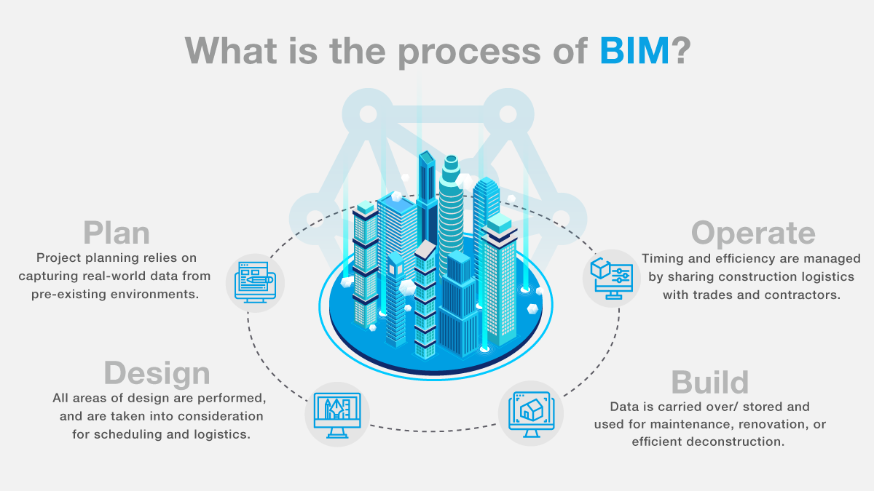
DEFINITION · K4
What is BIM?
• An intelligent 3D model-based process that gives AEC professionals every detail needed to plan, design, construct and manage buildings and infrastructure.
• Design and construction teams work more efficiently while capturing the data they create — benefiting operations, maintenance and future planning.
• Used across architecture, civil engineering, construction, plant, MEP and structural engineering to make better design decisions and improve building performance.
Application of BIM using Revit · TGS-2022015370
© 2026 Tertiary Infotech Academy Pte Ltd
21

Slide 23
BIM PROCESS · K1
The Process of BIM — Plan · Design · Build · Operate
Plan
Combine reality capture and real-world data to generate context models of the existing built and natural environment.
Design
Conceptual design, analysis, detailing and documentation — BIM data informs scheduling and logistics before construction begins.
1
2
Build
Fabrication starts from BIM specifications; construction logistics are shared with trades and contractors for optimum timing.
Operate
BIM data carries over to operations and maintenance — and later to cost-effective renovation or efficient deconstruction.
3
4
Application of BIM using Revit · TGS-2022015370
© 2026 Tertiary Infotech Academy Pte Ltd
22

Slide 24
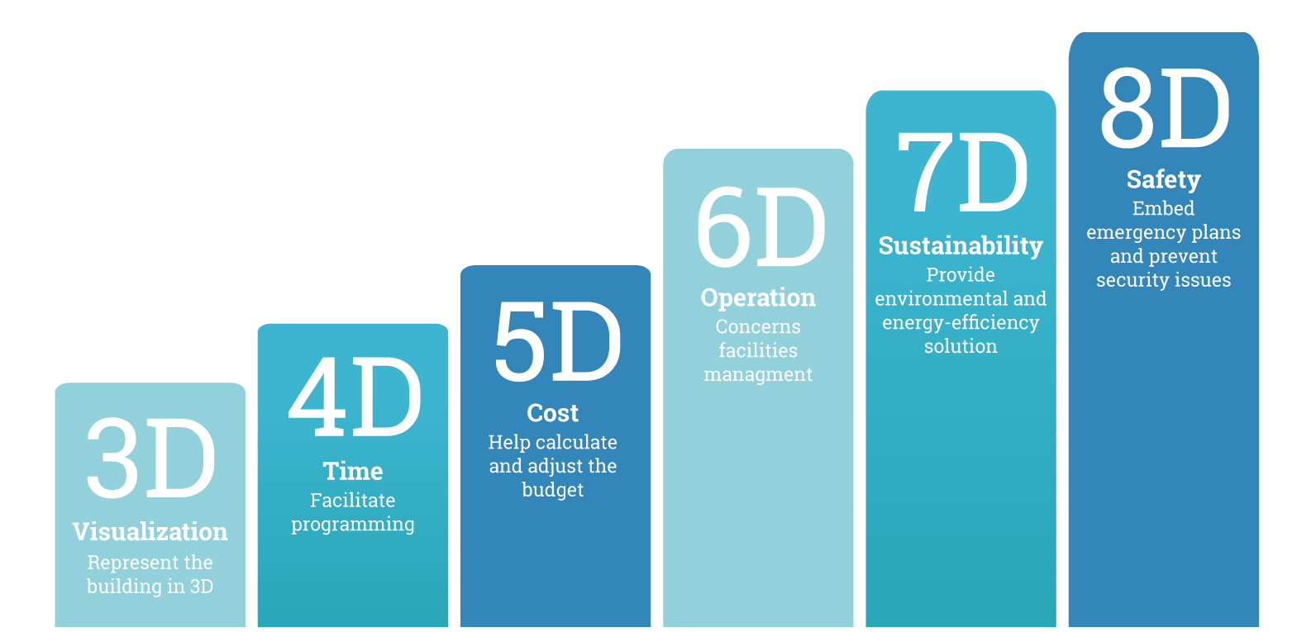
PRINCIPLES · K1
Principles of BIM
The BIM principles: one shared, coordinated, data-rich model across the project lifecycle.
Application of BIM using Revit · TGS-2022015370
© 2026 Tertiary Infotech Academy Pte Ltd
23

Slide 25
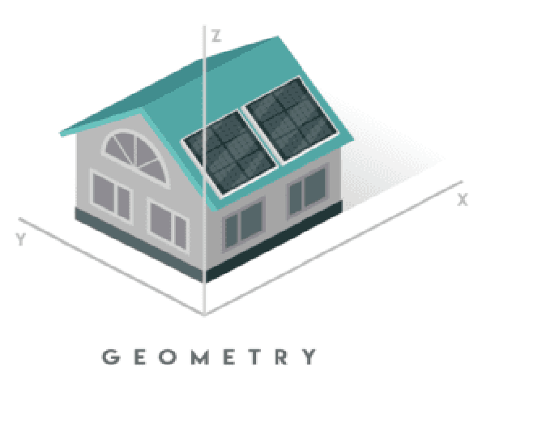
BIM DIMENSIONS · 1 OF 6
BIM Dimensions — 3D Geometry
• 3D BIM is the most common model type — the three geographic dimensions (x, y, z) of a structure.
• Helps stakeholders visualise the structure before the project starts.
• Gives AEC professionals the insight and tools to plan, design, construct and manage more efficiently.
Application of BIM using Revit · TGS-2022015370
© 2026 Tertiary Infotech Academy Pte Ltd
24

Slide 26

BIM DIMENSIONS · 2 OF 6
BIM Dimensions — 4D Time
• The 4th dimension adds project duration — timeline and scheduling information show how the project evolves over time.
• Extremely helpful for early-stage conflict detection, site planning and scheduling optimisation.
• Better communicates the next steps to stakeholders during every stage of construction.
Application of BIM using Revit · TGS-2022015370
© 2026 Tertiary Infotech Academy Pte Ltd
25

Slide 27

BIM DIMENSIONS · 3 OF 6
BIM Dimensions — 5D Cost
• 5D BIM visualises budget analysis and cost estimation — analysing project costs over time.
• Especially useful early on, to estimate costs of different design or construction scenarios.
• Tracks predicted vs actual cost with real-time notifications of cost overrun.
Application of BIM using Revit · TGS-2022015370
© 2026 Tertiary Infotech Academy Pte Ltd
26

Slide 28

BIM DIMENSIONS · 4 OF 6
BIM Dimensions — 6D Sustainability
• 6D BIM makes a structure self-sustainable and energy-efficient.
• Stakeholders analyse energy consumption and estimate energy usage during the initial design phase.
• Reduces energy consumption in the long run and improves operational management after construction.
Application of BIM using Revit · TGS-2022015370
© 2026 Tertiary Infotech Academy Pte Ltd
27

Slide 29

BIM DIMENSIONS · 5 OF 6
BIM Dimensions — 7D Facility Management
• 7D BIM improves operations and facility management for building owners and managers.
• Tracks asset data: status, warranty information, technical specifications, maintenance and operation manuals.
• Improves the maintenance process by listing all replacement parts and specifications.
Application of BIM using Revit · TGS-2022015370
© 2026 Tertiary Infotech Academy Pte Ltd
28

Slide 30
BIM DIMENSIONS · 6 OF 6
BIM Dimensions — 8D Safety, and the Full Stack
3D — Geometry
The shared x, y, z model every stakeholder visualises.
4D — Time
Schedule linked to the model; the build sequence becomes visible.
1
2
5D — Money
Cost estimation and budget tracking over time.
6D — Sustainability
Energy analysis from the design stage onwards.
3
4
7D — Facility Management
Asset data for operations and maintenance.
8D — Safety
Safety information added at design and execution — an overall picture of site risks and hazards for workers, before they occur.
5
6
Application of BIM using Revit · TGS-2022015370
© 2026 Tertiary Infotech Academy Pte Ltd
29

Slide 31
VALUE PROPOSITION · K2
Value Proposition — Advantages of BIM (1–4)
Maximised efficiency
Shorter project lifecycles; pre-construction and planning phases become easier to manage — everyone works off one up-to-date model, reducing errors and rework.
Reduced costs and wastage
Better material choices and streamlined construction work minimise human error and wasted materials — cutting cost.
1
2
Improved cost estimates
Model-based estimates from a detailed 3D model are more realistic and accurate, and quantity takeoffs become far easier.
Better insight into the project
A realistic 3D look at the eventual outcome helps contractors and clients feel the built asset — changes happen in pre-construction, not on site.
3
4
Application of BIM using Revit · TGS-2022015370
© 2026 Tertiary Infotech Academy Pte Ltd
30

Slide 32
VALUE PROPOSITION · K2
Value Proposition — Advantages of BIM (5–7)
Communication & collaboration
Cloud-based BIM lets everyone access up-to-date models anywhere, any time — estimates, models and design notes in one place.
Less risk
Closer collaboration reduces tender risk premiums, improves on-site safety and removes the risk of building from outdated information.
1
2
Better end results
Better planning and earlier visualisation produce a higher-quality build and a higher-quality built asset.
The common thread
Every advantage flows from one source: a single shared intelligent model that all stakeholders trust.
3
4
Application of BIM using Revit · TGS-2022015370
© 2026 Tertiary Infotech Academy Pte Ltd
31

Slide 33
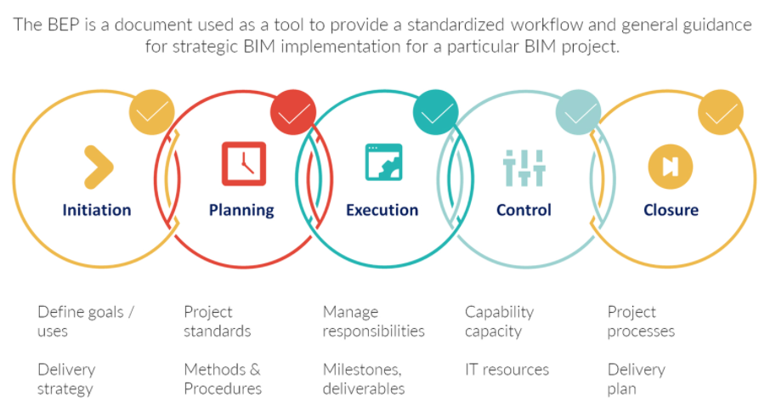
REQUIREMENTS · K3
The BIM Execution Plan (BEP)
• The BEP is the baseline document, approved by the Employer, that guides the project team in achieving the goals set — including BIM deliverables — throughout the project.
• It specifies the roles and responsibilities of project members when using BIM at different stages.
• It details how deliverables are created, coordinated, maintained and shared to satisfy the project goals.
• Defined at project start; updated (with the Employer's or BIM Manager's permission) when members or BIM uses change.
Application of BIM using Revit · TGS-2022015370
© 2026 Tertiary Infotech Academy Pte Ltd
32

Slide 34
REQUIREMENTS · K3
Typical Content of a BEP
1
Project information
2
Project members
3
Project goals & BIM uses for each project stage
4
BIM deliverables for each BIM use
5
Model author and users for each deliverable
6
Model elements, level of detail and attributes
7
Process for BIM creation, maintenance and collaboration
8
Exchange protocol, submittal format, technology infrastructure & software
Application of BIM using Revit · TGS-2022015370
© 2026 Tertiary Infotech Academy Pte Ltd
33

Slide 35
REQUIREMENTS · K3
Requirements of BIM — the Information Chain
OIR — Organisational Information Requirements
What the organisation needs to know to run its business.
AIR — Asset Information Requirements
What the organisation needs to know about the assets it is responsible for.
1
2
EIR — Employer Information Requirements
The information to be delivered, and the standards and processes to be adopted, for a construction project.
BEP — BIM Execution Plan
The overall vision and implementation details the project team follows throughout the project.
3
4
PIM — Project Information Model
The information model developed during the design and construction phase.
AIM — Asset Information Model
Graphical and non-graphical data, documents and metadata that support asset management.
5
6
Application of BIM using Revit · TGS-2022015370
© 2026 Tertiary Infotech Academy Pte Ltd
34

Slide 36
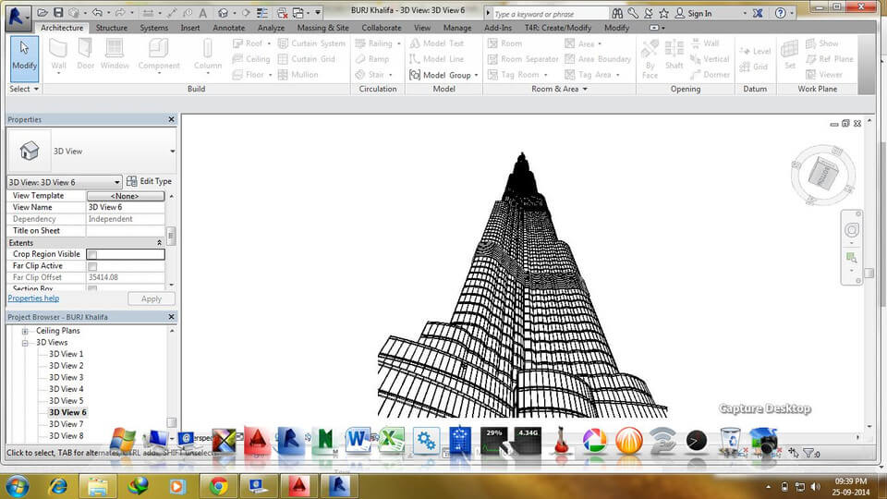
INTRODUCING REVIT · A2
What is Revit?
• A BIM-based platform used by architects, engineers, contractors and designers to create one unified model of real-life information.
• A design and documentation platform: one integrated building information model to conceptualise, design and document a project.
• Virtual modelling — see the building or infrastructure before it is built on-site.
• Its tools are built for BIM: an intelligent model with data stored in it — helping you avoid rework, minimise cost, detect conflicts before construction and avoid delays.
Application of BIM using Revit · TGS-2022015370
© 2026 Tertiary Infotech Academy Pte Ltd
35

Slide 37
WHAT YOU'LL DO
Hands-On Labs — Introduction to BIM and Revit
Lab 1
Lab 2
—
• Get Started with Revit
• Convert 2D Information into a 3D Model
• —
Application of BIM using Revit · TGS-2022015370
© 2026 Tertiary Infotech Academy Pte Ltd
36

Slide 38
TOPIC 01 · HANDS-ON
Get Started with Revit
LAB 1
Tour the Revit environment on a real model: open the Autodesk sample architecture project, learn the ribbon, Properties palette, Project Browser and drawing area, then navigate plans, elevations, sections and the 3D view.
You'll build
A guided tour of a complete BIM model — you can open any view, orbit the 3D model and inspect element properties.
Tools: Autodesk Revit 2024/2025, Autodesk sample project (rac_basic_sample_project.rvt)
Application of BIM using Revit · TGS-2022015370
© 2026 Tertiary Infotech Academy Pte Ltd
37

Slide 39
LAB 1 · STEP-BY-STEP
Get Started with Revit
1
Launch Revit. On the Home screen under Models click Open, browse to the Revit sample files and open the basic architecture sample project.
of 6
Home ▸ Models ▸ Open ▸ rac_basic_sample_project.rvt
2
Identify the four working zones: the ribbon (tools), the Properties palette (instance/type properties), the Project Browser (all views, schedules, sheets, families) and the drawing area.
of 6
Application of BIM using Revit · TGS-2022015370
© 2026 Tertiary Infotech Academy Pte Ltd
38

Slide 40
LAB 1 · STEP-BY-STEP
Get Started with Revit
3
In the Project Browser expand Floor Plans and double-click Level 1. Zoom and pan with the mouse wheel; hover over a wall and read its description on the status bar.
of 6
Project Browser ▸ Floor Plans ▸ Level 1
4
Select a wall and inspect the Properties palette: note its Type (in the Type Selector), Base Constraint and Top Constraint. Click Edit Type to view (not change) the type parameters.
of 6
Properties ▸ Type Selector / Edit Type
Application of BIM using Revit · TGS-2022015370
© 2026 Tertiary Infotech Academy Pte Ltd
39

Slide 41
LAB 1 · STEP-BY-STEP
Get Started with Revit
5
Open the default 3D view and orbit the model with Shift + middle-mouse drag. Use the ViewCube to jump to Front, Top and corner views.
of 6
Quick Access Toolbar ▸ Default 3D View
6
Open an elevation and a section view from the Project Browser, and tile the windows to see the same model in several views at once.
of 6
View ▸ Windows ▸ Tile Views
Application of BIM using Revit · TGS-2022015370
© 2026 Tertiary Infotech Academy Pte Ltd
40

Slide 42
LAB 1 · VERIFY
Get Started with Revit
✅ Test it
You can name the four zones of the Revit UI, open any plan/elevation/section/3D view from the Project Browser, and read a selected element's type and constraints in the Properties palette — one model driving every view is the essence of BIM.
Application of BIM using Revit · TGS-2022015370
© 2026 Tertiary Infotech Academy Pte Ltd
41

Slide 43
TOPIC 01 · HANDS-ON
Convert 2D Information into a 3D Model
LAB 2
Turn a 2D PDF floor plan into an intelligent 3D model: create gridlines and walls to match the drawing, set the exterior walls to the 12" Generic type and interior walls to the 6" Generic type, constrain wall tops to Level 2 and give the corner a 30 ft radius — then add construction information to the model.
You'll build
A 3D building model reproduced from a 2D plan, with correctly typed exterior/interior walls constrained to levels.
Tools: Autodesk Revit, 2D floor plan PDF (from the LMS lab files)
Application of BIM using Revit · TGS-2022015370
© 2026 Tertiary Infotech Academy Pte Ltd
42

Slide 44
LAB 2 · STEP-BY-STEP
Convert 2D Information into a 3D Model
1
Start a new project from the Architectural template and link the 2D floor plan PDF into the Level 1 plan view as a reference underlay.
of 6
File ▸ New ▸ Project ▸ Architectural Template · Insert ▸ Link PDF
2
Place vertical and horizontal gridlines to match the grid intersections shown on the PDF.
of 6
Architecture ▸ Datum ▸ Grid
Application of BIM using Revit · TGS-2022015370
© 2026 Tertiary Infotech Academy Pte Ltd
43

Slide 45
LAB 2 · STEP-BY-STEP
Convert 2D Information into a 3D Model
3
Draw the exterior walls over the PDF using the 12" Generic wall type. In the Options Bar set Height to Level 2.
of 6
Architecture ▸ Build ▸ Wall: Architectural ▸ Generic - 12"
4
Draw the interior partition walls with the 6" Generic wall type, also constrained to Level 2.
of 6
Architecture ▸ Build ▸ Wall: Architectural ▸ Generic - 6"
Application of BIM using Revit · TGS-2022015370
© 2026 Tertiary Infotech Academy Pte Ltd
44

Slide 46
LAB 2 · STEP-BY-STEP
Convert 2D Information into a 3D Model
5
Create the curved corner wall with the Fillet Arc draw tool and set the radius to 30 ft (30' 0").
of 6
Modify | Place Wall ▸ Draw ▸ Fillet Arc ▸ Radius = 30'
6
Open the default 3D view and verify the model: all walls rise from Level 1 to Level 2 and the plan matches the PDF. Select any wall and confirm its Top Constraint reads 'Up to level: Level 2'.
of 6
Quick Access Toolbar ▸ Default 3D View
Application of BIM using Revit · TGS-2022015370
© 2026 Tertiary Infotech Academy Pte Ltd
45

Slide 47
LAB 2 · VERIFY
Convert 2D Information into a 3D Model
✅ Test it
The 3D view shows a closed building shell that matches the 2D PDF: exterior walls are Generic - 12", interior walls are Generic - 6", every wall's Top Constraint is Level 2, and the corner wall has a 30 ft radius — 2D information has become an intelligent, parametric 3D model.
Application of BIM using Revit · TGS-2022015370
© 2026 Tertiary Infotech Academy Pte Ltd
46

Slide 48
TOPIC RECAP
Recap — Introduction to BIM and Revit
• You can now: LO1 — Apply Revit for Building Information Modelling (BIM)
Application of BIM using Revit · TGS-2022015370
© 2026 Tertiary Infotech Academy Pte Ltd
47

Slide 49
02
TOPIC 02
BIM Modeling
Develop models for building elements · walls, floors, ceilings, roofs, stairs, structure · site and topography · massing · BIM design integration
Application of BIM using Revit · TGS-2022015370
© 2026 Tertiary Infotech Academy Pte Ltd
48

Slide 50
ALIGNMENT: K6, K7 · A4, A5 · LO2
Key Concepts — BIM Modeling
Everything is parametric
Each component has parametric qualities — change the model once and every related view, schedule and sheet updates automatically.
Model with the right tool
Walls, curtain walls, floors, ceilings, roofs, stairs, railings — each element is created with its dedicated tool and family type.
1
2
Structure lives in the model
Structural columns, beams, beam systems, trusses and braces carry the load path inside the same coordinated model.
Site gives context
Toposurfaces, subregions, graded regions and building pads model the terrain the building sits on.
3
4
Mass first, detail later
Conceptual masses and generative design (Dynamo) explore building volumes before committing to detailed elements.
Families drive integration
System, loadable and in-place families — with materials and parameters — integrate design information into every element.
5
6
Application of BIM using Revit · TGS-2022015370
© 2026 Tertiary Infotech Academy Pte Ltd
49

Slide 51
WHY REVIT MODELING · K7
Develop Models for Building Elements
Parametric objects
Each component has parametric qualities that drive its behaviour.
Quick changes, no repetition
One change updates every related component, view, detail and document automatically.
1
2
Construction documentation
High-quality documentation produced automatically from the 3D model.
Quantities & cost estimation
Generated automatically from the data inserted in the model.
3
4
Coordination & 3D visualisation
Shared models reduce conflicts and communicate design to client and team.
Interoperability
Revit imports, exports and links data in common formats such as IFC.
5
6
Application of BIM using Revit · TGS-2022015370
© 2026 Tertiary Infotech Academy Pte Ltd
50

Slide 52
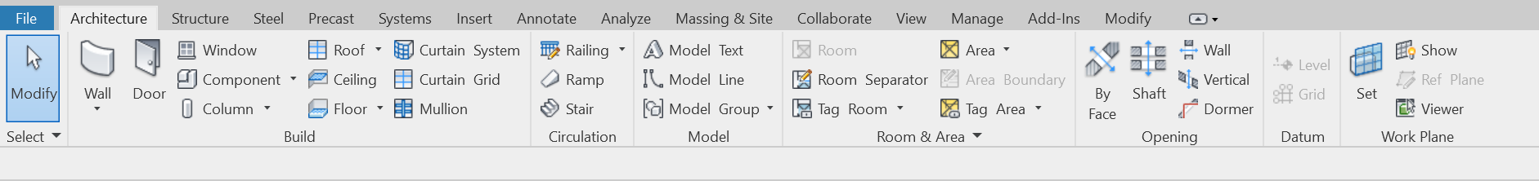
WALLS · A4
Modeling Walls
• Add instances of a wall type in a floor plan or 3D view: Architecture ▸ Build ▸ Wall ▸ Wall: Architectural (structural walls work the same way).
• Pick the wall type in the Type Selector; adjust instance properties in the Properties palette before placing.
• Options Bar: Level (base constraint), Height (top constraint), Location Line (which plane follows the cursor), Chain, Offset and Join Status.
Application of BIM using Revit · TGS-2022015370
© 2026 Tertiary Infotech Academy Pte Ltd
51

Slide 53
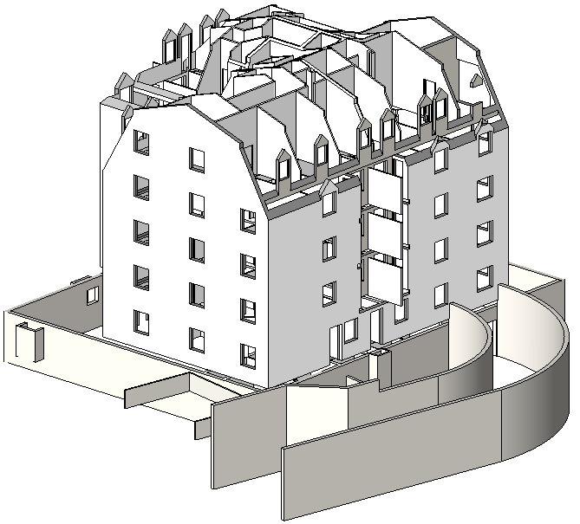
WALLS · A4
Wall Placement Options
• Location Line — align the wall's centreline, core face or finish face with the cursor as you draw.
• Chain — draw a series of wall segments connected at endpoints.
• Offset — place the wall's location line at a distance from the cursor or a picked line/face.
• Join Status — Allow creates a butt join where walls intersect; Disallow prevents joining.
Application of BIM using Revit · TGS-2022015370
© 2026 Tertiary Infotech Academy Pte Ltd
52

Slide 54
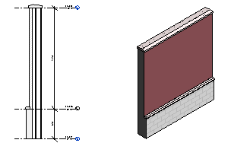
WALLS · A4
Stacked and Embedded Walls
• Stacked walls: two or more subwalls of different thicknesses stacked at different heights — attached, with joined geometry.
• Embed a wall into a host wall (wall-in-wall, wall-in-curtain-wall or curtain-wall-in-wall).
• The embedded wall must be smaller than its host; use Cut Geometry, picking the HOST wall first, then the wall to embed.
• Resize an embedded wall with its drag controls after embedding.
Application of BIM using Revit · TGS-2022015370
© 2026 Tertiary Infotech Academy Pte Ltd
53

Slide 55
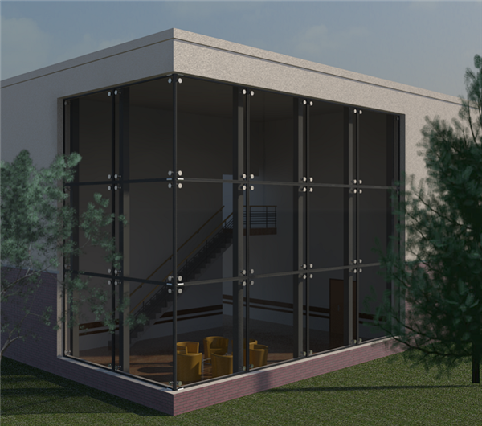
CURTAIN WALLS · A4
Modeling Curtain Walls
• A curtain wall is placed like any wall — just select a curtain wall type (Curtain Wall 1, Exterior Glazing, Storefront) in the Type Selector.
• Divide the wall into panels with Curtain Grid; customise grids with Add/Remove Segments.
• Place mullions on grid lines; Tab-select any panel to change its type — even to a door panel.
• Doors and walls can be embedded within curtain panels.
Application of BIM using Revit · TGS-2022015370
© 2026 Tertiary Infotech Academy Pte Ltd
54

Slide 56
FLOORS · A4
Modeling Floors and Openings
• Create a floor by picking walls or sketching its boundary — the boundary must be a closed loop; sketch a second loop inside to form an opening.
• Options Bar: Offset for floor edges; 'Extend into wall (to core)' measures the offset from the wall's core.
• Opening tools: By Face (perpendicular to the face), Vertical (perpendicular to a level), Shaft (cuts every level it spans), Wall Opening and Dormer.
Application of BIM using Revit · TGS-2022015370
© 2026 Tertiary Infotech Academy Pte Ltd
55

Slide 57
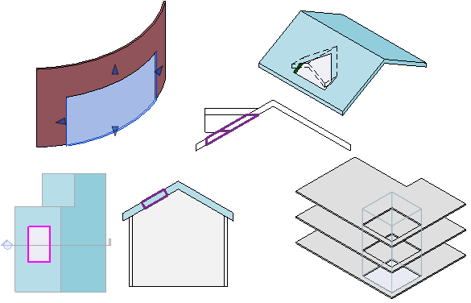
FLOORS · A4
Shaft Openings and View Range
• A Shaft cuts through roofs, floors and ceilings across its Base and Top Constraints — move it on one level and it moves on all levels.
• Every plan view has a View Range: Top, Cut Plane and Bottom planes define what is shown and how.
• View Depth adds a plane beyond the primary range to show elements below the bottom clip plane.
Application of BIM using Revit · TGS-2022015370
© 2026 Tertiary Infotech Academy Pte Ltd
56

Slide 58
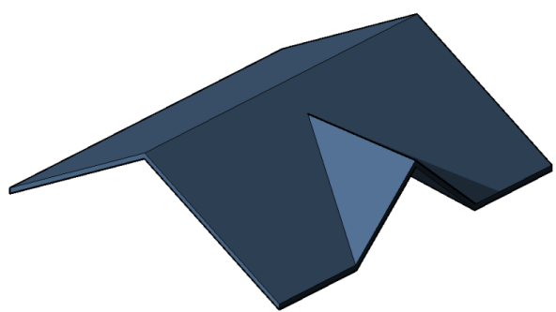
CEILINGS & ROOFS · A4
Modeling Ceilings and Roofs
• Ceilings are placed in a reflected ceiling plan — Automatic Ceiling fills a closed wall loop; Sketch Ceiling draws a custom boundary.
• Roof by Footprint: sketch/pick a closed loop in a plan view; slope-defining edges create hips and gables.
• A roof cannot cut through windows or doors.
Application of BIM using Revit · TGS-2022015370
© 2026 Tertiary Infotech Academy Pte Ltd
57

Slide 59
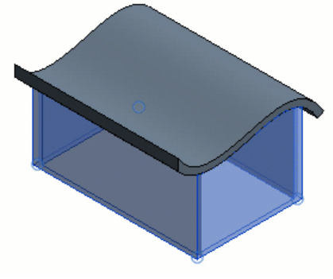
CEILINGS & ROOFS · A4
Roof by Extrusion
• Create a roof by extruding an open-loop profile sketched in an elevation, 3D or section view.
• Set the Roof Reference Level and Offset — a reference plane controls the roof's position.
• After creating it, attach walls to the roof, rehost it or edit its work plane.
Application of BIM using Revit · TGS-2022015370
© 2026 Tertiary Infotech Academy Pte Ltd
58

Slide 60
CIRCULATION · A4
Modeling Stairs and Railings
• Stairs assemble from components in edit mode: runs (straight, spiral, U-, L-shaped, sketched), landings, supports and railings.
• Railings: free-standing on levels, attached to hosts (floors, ramps, stairs), auto-created with stairs, or sketched with a custom path and Pick New Host.
• Tile plan + 3D views while assembling to see the full stair model as you work.
Application of BIM using Revit · TGS-2022015370
© 2026 Tertiary Infotech Academy Pte Ltd
59

Slide 61
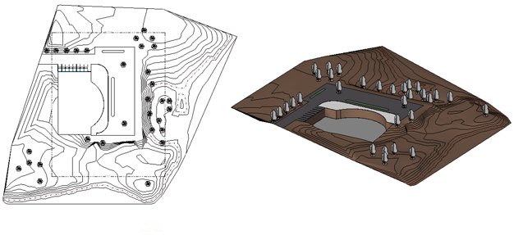
SITE · A4
Site and Topography
• The Toposurface tool defines terrain from points placed at absolute or relative elevations, in 3D or site plan views.
• Subregion applies different properties (e.g. material) to an area; Split and Merge Surfaces divide and rejoin terrain; Graded Region develops the proposed site design.
• A Building Pad sketched on the toposurface cuts the terrain at a controlled level offset — with openings and slope if needed.
Application of BIM using Revit · TGS-2022015370
© 2026 Tertiary Infotech Academy Pte Ltd
60

Slide 62
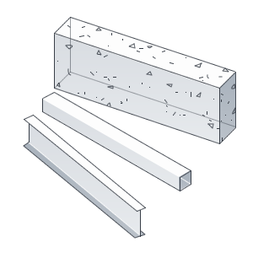
STRUCTURE · A5
Structural Columns and Framing
• Structural columns add vertical load-bearing elements: Structure ▸ Column, or At Grids for batch placement.
• Beams span supports; a Beam System fills a boundary with members per a layout rule; 3D option for sloped systems.
• Trusses place framing per the selected truss family's layout; braces sketch diagonally between structural elements in plan or framing elevations.
Application of BIM using Revit · TGS-2022015370
© 2026 Tertiary Infotech Academy Pte Ltd
61

Slide 63
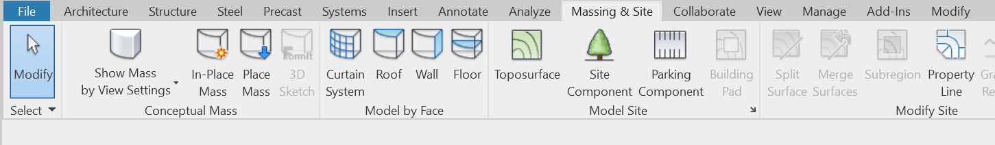
MASSING · A4
Conceptual Masses
• Mass modeling drafts conceptual volumes fast — as Conceptual Mass families (outside the project) or In-Place Masses (inside it).
• Use massing studies for design options, phase representation, zoning compliance (visually and numerically) and assembling complex forms from mass families.
• Generate floors, roofs, curtain systems and walls from mass instances — regenerating under control when the mass changes; schedule gross volume, floor area and surface area.
Application of BIM using Revit · TGS-2022015370
© 2026 Tertiary Infotech Academy Pte Ltd
62

Slide 64
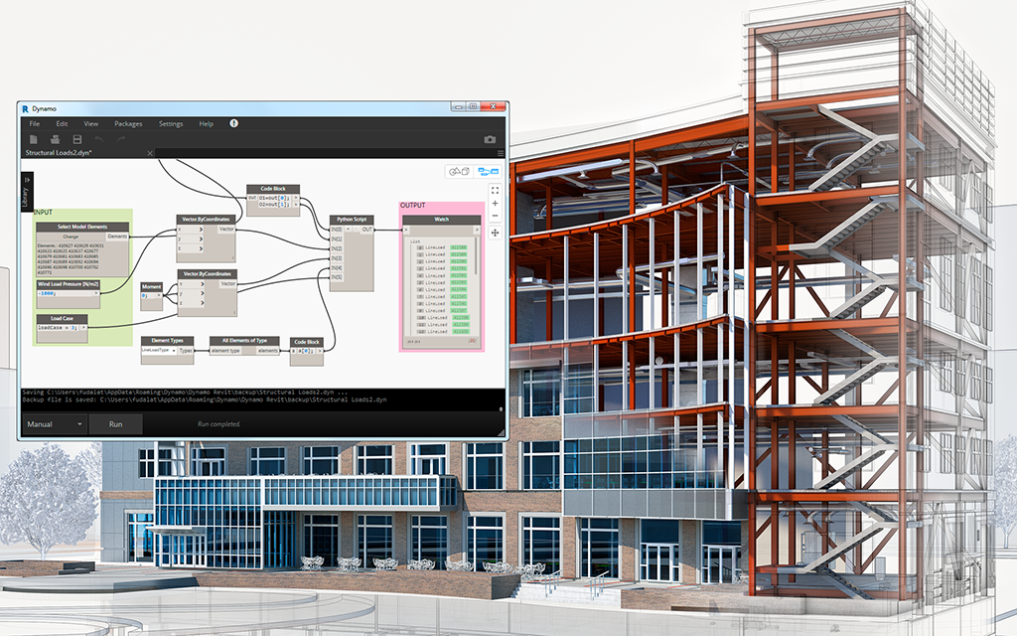
GENERATIVE DESIGN · K6
Generative Design and Dynamo
• Generative design (AEC Collection) generates design alternatives from your inputs, constraints and goals.
• Dynamo is Revit's visual-programming add-in — open-source graphical programming for custom computational design and BIM automation.
• Workflow: build a Dynamo graph, declare Is Input / Is Output on nodes, export for generative design, then review the study's outcomes.
Application of BIM using Revit · TGS-2022015370
© 2026 Tertiary Infotech Academy Pte Ltd
63

Slide 65
FAMILIES · K6
Families and Parameters
The three kinds
Loading & catalogs
• System families
– Walls, roofs, floors, ducts, pipes — predefined in Revit, never loaded from external files
– Levels, grids, sheets and viewports are system families too
• In-place families
– Unique, project-specific elements created with Family Editor tools
– Reference other geometry and adjust when it changes
• Loadable families
– Windows, doors, casework, fixtures, furniture, boilers, plumbing — RFA files loaded via Insert ▸ Load Family
– Combine into nested and shared families
• Type catalogs
– Load only the types you need from large families (e.g. one C-Channel size, not dozens)
– Keeps project size down and the Type Selector short
Application of BIM using Revit · TGS-2022015370
© 2026 Tertiary Infotech Academy Pte Ltd
64

Slide 66
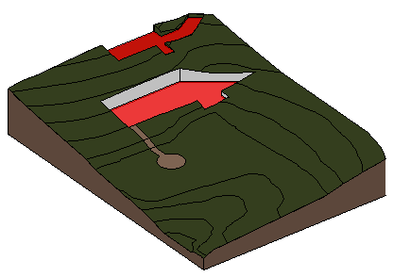
MATERIALS · A5
Materials
• Materials control how elements display in views and rendered images: Manage ▸ Settings ▸ Materials.
• They define Graphics, Appearance, Thermal and Physical information — for visualisation, analysis and scheduling.
• Apply by category or subcategory, by family, by element parameter, or by face with the Paint tool.
Application of BIM using Revit · TGS-2022015370
© 2026 Tertiary Infotech Academy Pte Ltd
65

Slide 67
WHAT YOU'LL DO
Hands-On Labs — BIM Modeling
Labs 3–4
Labs 5–6
—
• Modeling Walls — Reveals, Embedded and Curtain Walls
• Floors, Ceilings, Roofs and Openings
• Stairs, Railings and Structural Elements
• Terrain, Building Pad and Conceptual Mass
• —
Application of BIM using Revit · TGS-2022015370
© 2026 Tertiary Infotech Academy Pte Ltd
66

Slide 68
TOPIC 02 · HANDS-ON
Modeling Walls — Reveals, Embedded and Curtain Walls
LAB 3
Work with advanced wall modeling on the Embed Walls project: place brick-course wall reveals on an elevation, duplicate a wall type into a new Vertical Cladding type, embed the new walls into an existing wall with Cut Geometry, and add a curtain wall with grids and mullions.
You'll build
A facade with three positioned reveals, embedded Vertical Cladding walls joined into the host wall, and a gridded curtain wall.
Tools: Autodesk Revit, Embed Walls.rvt (LMS lab files)
Application of BIM using Revit · TGS-2022015370
© 2026 Tertiary Infotech Academy Pte Ltd
67

Slide 69
LAB 3 · STEP-BY-STEP
Modeling Walls — Reveals, Embedded and Curtain Walls
1
Open Embed Walls.rvt. Start the Wall: Reveal tool, edit its type properties and change the profile to Reveal-Brick Course: 3 Bricks.
of 6
Architecture ▸ Build ▸ Wall ▸ Wall: Reveal ▸ Edit Type
2
Place three reveals on the end elevation wall at the dimensions given in the drawing, each with Offset from Wall = 1".
of 6
Modify | Place Reveal ▸ set Offset from Wall = 1"
Application of BIM using Revit · TGS-2022015370
© 2026 Tertiary Infotech Academy Pte Ltd
68

Slide 70
LAB 3 · STEP-BY-STEP
Modeling Walls — Reveals, Embedded and Curtain Walls
3
Open the Floor 2 plan. Start a new wall, select the Stone on CMU type, duplicate it and name the new type Vertical Cladding; change Layer 1's material to Cladding, Vertical Ribbed.
of 6
Architecture ▸ Wall ▸ Edit Type ▸ Duplicate ▸ 'Vertical Cladding'
4
Draw three lengths of the Vertical Cladding wall per the plan dimensions, with Base Constraint = Floor 2 and Top Constraint = Roof, then Align their tops/bottoms to the reveals.
of 6
Modify ▸ Align
Application of BIM using Revit · TGS-2022015370
© 2026 Tertiary Infotech Academy Pte Ltd
69

Slide 71
LAB 3 · STEP-BY-STEP
Modeling Walls — Reveals, Embedded and Curtain Walls
5
Use Cut Geometry to embed the Vertical Cladding walls into the existing host wall (pick the host first), then Join Geometry to remove the end edges in plan.
of 6
Modify ▸ Geometry ▸ Cut / Join
6
Add a curtain wall: place a wall with a curtain wall type, divide it with Curtain Grid, and place mullions on the grid lines. Tab-select a panel and swap its type in the Type Selector.
of 6
Architecture ▸ Wall ▸ Curtain Wall 1 · Architecture ▸ Build ▸ Curtain Grid / Mullion
Application of BIM using Revit · TGS-2022015370
© 2026 Tertiary Infotech Academy Pte Ltd
70

Slide 72
LAB 3 · VERIFY
Modeling Walls — Reveals, Embedded and Curtain Walls
✅ Test it
The elevation shows three brick-course reveals at the specified dimensions; the Vertical Cladding walls sit flush inside the host wall with clean joins in plan; and the curtain wall shows a grid of panels with mullions — Tab-selection lets you re-type any single panel.
Application of BIM using Revit · TGS-2022015370
© 2026 Tertiary Infotech Academy Pte Ltd
71

Slide 73
TOPIC 02 · HANDS-ON
Floors, Ceilings, Roofs and Openings
LAB 4
Complete the horizontal envelope of the building: create a floor by picking walls, add a ceiling in a reflected ceiling plan, create a roof by footprint with slope-defining edges and a second roof by extrusion, then cut a vertical shaft opening through the levels.
You'll build
A building with floors, ceilings, a footprint roof and an extruded roof, plus a shaft opening cutting through every level.
Tools: Autodesk Revit, your Lab 2 model (or the LMS lab file)
Application of BIM using Revit · TGS-2022015370
© 2026 Tertiary Infotech Academy Pte Ltd
72

Slide 74
LAB 4 · STEP-BY-STEP
Floors, Ceilings, Roofs and Openings
1
Create the Level 1 floor: pick the exterior walls as boundaries (Extend into wall (to core)), and finish the sketch — the boundary must be a closed loop.
of 6
Architecture ▸ Build ▸ Floor: Architectural ▸ Pick Walls
2
Open the Level 1 ceiling plan and place a ceiling with Automatic Ceiling by clicking inside the walls that form a closed loop.
of 6
Architecture ▸ Build ▸ Ceiling ▸ Automatic Ceiling
Application of BIM using Revit · TGS-2022015370
© 2026 Tertiary Infotech Academy Pte Ltd
73

Slide 75
LAB 4 · STEP-BY-STEP
Floors, Ceilings, Roofs and Openings
3
Create the main roof by footprint on Level 2: pick the walls with an overhang, keep Defines Slope on for all edges, and finish — then open 3D to see the hips form.
of 6
Architecture ▸ Build ▸ Roof ▸ Roof by Footprint
4
Create a porch roof by extrusion: in an elevation view sketch an open-loop profile and extrude it, then Attach the porch walls to the underside of the roof.
of 6
Architecture ▸ Build ▸ Roof ▸ Roof by Extrusion · Modify Wall ▸ Attach Top/Base
Application of BIM using Revit · TGS-2022015370
© 2026 Tertiary Infotech Academy Pte Ltd
74

Slide 76
LAB 4 · STEP-BY-STEP
Floors, Ceilings, Roofs and Openings
5
Cut a shaft for the stair: sketch a closed loop with the Shaft tool, set Base Constraint = Level 1 and Top Constraint = Roof, and finish the opening.
of 6
Architecture ▸ Opening ▸ Shaft
6
Verify in a section view that the shaft cuts the floor and ceiling on every intermediate level, and use By Face / Vertical openings where a duct or chimney penetrates the roof.
of 6
Architecture ▸ Opening ▸ By Face / Vertical
Application of BIM using Revit · TGS-2022015370
© 2026 Tertiary Infotech Academy Pte Ltd
75

Slide 77
LAB 4 · VERIFY
Floors, Ceilings, Roofs and Openings
✅ Test it
The section view shows floor, ceiling and both roofs in place; the shaft opening cuts cleanly through every level it spans; and moving the shaft in one plan moves it on all levels — the model stays coordinated because every view reads the same database.
Application of BIM using Revit · TGS-2022015370
© 2026 Tertiary Infotech Academy Pte Ltd
76

Slide 78
TOPIC 02 · HANDS-ON
Stairs, Railings and Structural Elements
LAB 5
Add vertical circulation and the load path: assemble a stair from runs and landings, host a railing on a floor edge with Sketch Path, then place structural columns on the grid intersections and frame them with beams, a beam system and a brace.
You'll build
A stair with railings connecting two levels, plus a structural frame of columns, beams, a beam system and a brace.
Tools: Autodesk Revit, your Lab 2/4 model (or the LMS lab file)
Application of BIM using Revit · TGS-2022015370
© 2026 Tertiary Infotech Academy Pte Ltd
77

Slide 79
LAB 5 · STEP-BY-STEP
Stairs, Railings and Structural Elements
1
Create a stair between Level 1 and Level 2: in stair assembly mode place a straight Run; a landing is created automatically between two runs. Finish and inspect it in 3D.
of 6
Architecture ▸ Circulation ▸ Stair ▸ Run
2
Add a railing along the Level 2 floor edge: Sketch Path, draw the railing line, use Pick New Host to host it on the floor, and finish.
of 6
Architecture ▸ Circulation ▸ Railing ▸ Sketch Path ▸ Pick New Host
Application of BIM using Revit · TGS-2022015370
© 2026 Tertiary Infotech Academy Pte Ltd
78

Slide 80
LAB 5 · STEP-BY-STEP
Stairs, Railings and Structural Elements
3
Place structural columns at grid intersections from Level 1 to Level 2 (use At Grids to place several at once).
of 6
Structure ▸ Structure ▸ Column ▸ At Grids
4
Draw beams between column tops on Level 2, snapping from column to column.
of 6
Structure ▸ Structure ▸ Beam
Application of BIM using Revit · TGS-2022015370
© 2026 Tertiary Infotech Academy Pte Ltd
79

Slide 81
LAB 5 · STEP-BY-STEP
Stairs, Railings and Structural Elements
5
Fill a bay with a Beam System: sketch its boundary with Pick Supports, set the Beam Type and Layout Rule (e.g. Fixed Distance), and finish.
of 6
Structure ▸ Structure ▸ Beam System ▸ Sketch Beam System
6
Open a framing elevation and add a diagonal Brace between a column and a beam, snapping to their ends.
of 6
Structure ▸ Structure ▸ Brace
Application of BIM using Revit · TGS-2022015370
© 2026 Tertiary Infotech Academy Pte Ltd
80

Slide 82
LAB 5 · VERIFY
Stairs, Railings and Structural Elements
✅ Test it
The stair connects the two levels with automatically generated railings; columns stand on every chosen grid intersection; the beam system spaces its members per the layout rule; and the brace runs diagonally in the framing elevation — the architectural and structural elements coexist in one coordinated model.
Application of BIM using Revit · TGS-2022015370
© 2026 Tertiary Infotech Academy Pte Ltd
81

Slide 83
TOPIC 02 · HANDS-ON
Terrain, Building Pad and Conceptual Mass
LAB 6
Set the building into its site: create a toposurface by placing points at different elevations, add a building pad from the foundation footprint, frame the 3D view with a section box, apply a grass material — then explore an in-place conceptual mass and preview generative design with Dynamo.
You'll build
A site terrain with a building pad cut into it, a realistic 3D view, and an in-place conceptual mass volume.
Tools: Autodesk Revit, GSG_03_Terrain_Pad.rvt (LMS lab files), Dynamo
Application of BIM using Revit · TGS-2022015370
© 2026 Tertiary Infotech Academy Pte Ltd
82

Slide 84
LAB 6 · STEP-BY-STEP
Terrain, Building Pad and Conceptual Mass
1
Open GSG_03_Terrain_Pad.rvt and the Site plan. Start Toposurface and place points around the building at Elevation 0, then rings of points further out at higher elevations to slope the ground.
of 6
Massing & Site ▸ Model Site ▸ Toposurface ▸ Place Point
2
Finish the surface and open the 3D view — the terrain now buries part of the building.
of 6
Massing & Site ▸ Toposurface ▸ ✓ Finish Surface
Application of BIM using Revit · TGS-2022015370
© 2026 Tertiary Infotech Academy Pte Ltd
83

Slide 85
LAB 6 · STEP-BY-STEP
Terrain, Building Pad and Conceptual Mass
3
Add a Building Pad: sketch its boundary with Pick Walls on the foundation walls, set the pad level, and finish — the pad cuts the terrain away from the building.
of 6
Massing & Site ▸ Model Site ▸ Building Pad
4
Frame the model with a Section Box in the 3D view's properties and drag its grips to crop the terrain neatly around the building.
of 6
3D View ▸ Properties ▸ Section Box
Application of BIM using Revit · TGS-2022015370
© 2026 Tertiary Infotech Academy Pte Ltd
84

Slide 86
LAB 6 · STEP-BY-STEP
Terrain, Building Pad and Conceptual Mass
5
Select the toposurface, and in the Material parameter choose a grass material for a realistic render, then explore Subregion, Split Surface and Graded Region on the Massing & Site tab.
of 6
Toposurface ▸ Properties ▸ Material ▸ Grass
6
Create an In-Place Mass: name it, sketch a profile and create a form, then Finish Mass — and open Manage ▸ Dynamo to see how a graph of nodes can drive such geometry for generative design.
of 6
Massing & Site ▸ Conceptual Mass ▸ In-Place Mass · Manage ▸ Dynamo
Application of BIM using Revit · TGS-2022015370
© 2026 Tertiary Infotech Academy Pte Ltd
85

Slide 87
LAB 6 · VERIFY
Terrain, Building Pad and Conceptual Mass
✅ Test it
The 3D view shows the building sitting in a grass-covered terrain with a clean pad cut into the slope, the section box crops the site tidily, and your in-place mass appears as a volume you could later turn into walls, floors and roofs — site, mass and building live in one model.
Application of BIM using Revit · TGS-2022015370
© 2026 Tertiary Infotech Academy Pte Ltd
86

Slide 88
TOPIC RECAP
Recap — BIM Modeling
• You can now: LO2 — Develop models and integrate design for BIM
Application of BIM using Revit · TGS-2022015370
© 2026 Tertiary Infotech Academy Pte Ltd
87

Slide 89
03
TOPIC 03
BIM Application
Apply and operate BIM · technologies used in BIM · interpret output · schedules and quantity takeoffs · analyse performance and check compliance
Application of BIM using Revit · TGS-2022015370
© 2026 Tertiary Infotech Academy Pte Ltd
88

Slide 90
ALIGNMENT: K5 · A6, A7, A8 · LO3
Key Concepts — BIM Application
BIM manages the build
Construction simulation, information statistics and real-time monitoring strengthen quality and process management on site.
Views interpret the model
View range, view templates, callouts and section views turn one model into many purpose-built, readable outputs.
1
2
Schedules read the database
Schedules and quantity takeoffs tabulate elements straight from the model — the model IS the quantity database.
Cost from the model
Calculated-value formulas and material takeoffs produce preliminary cost estimates that update as the design changes.
3
4
Analyse before you build
Revit Systems Analysis translates the model to EnergyPlus to simulate heating, cooling and annual energy performance.
Check, then comply
Interference (clash) checks and analysis reports verify design performance and compliance before construction.
5
6
Application of BIM using Revit · TGS-2022015370
© 2026 Tertiary Infotech Academy Pte Ltd
89

Slide 91
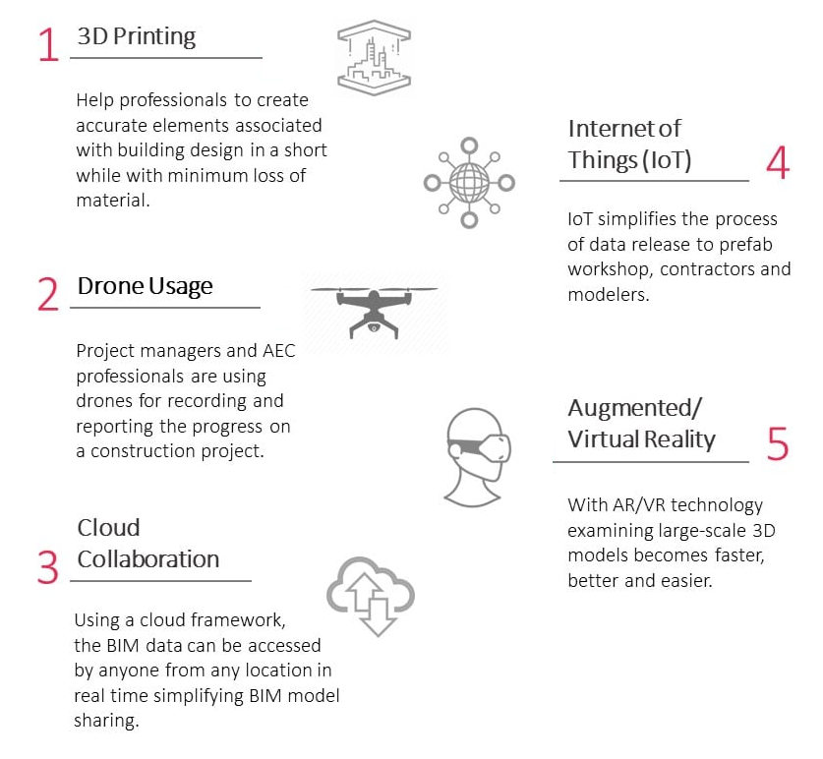
TECHNOLOGY LANDSCAPE · K6
Technologies Used in BIM
The technology stack around BIM: authoring, analysis, collaboration, field and FM tools.
Application of BIM using Revit · TGS-2022015370
© 2026 Tertiary Infotech Academy Pte Ltd
90

Slide 92
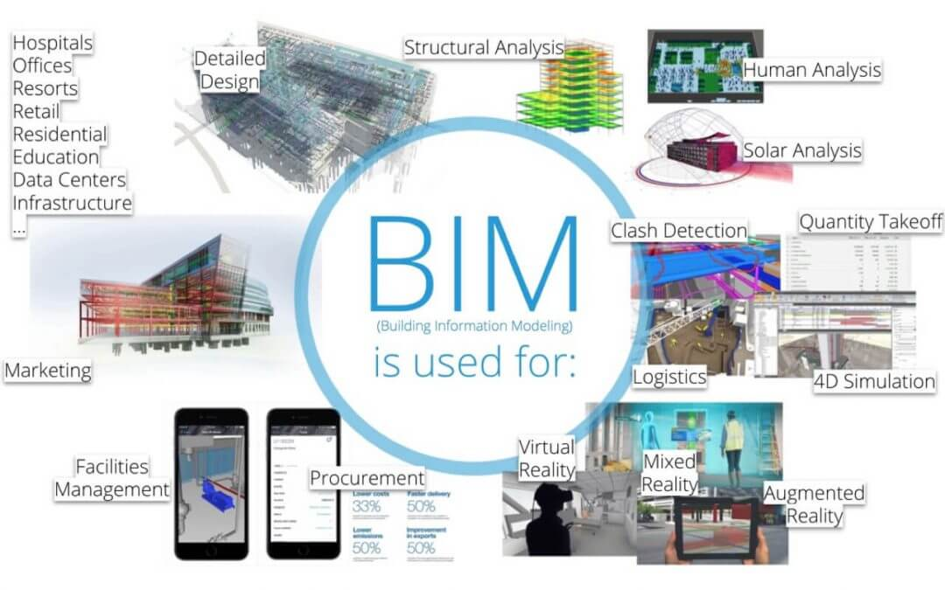
APPLICATION · K5
Application of BIM in Construction Management
• BIM supports construction simulation and information statistics — management processes become visual and controllable.
• Quality management covers both the product and the technical process.
• Real-time monitoring of the construction process helps ensure construction quality on site.
Application of BIM using Revit · TGS-2022015370
© 2026 Tertiary Infotech Academy Pte Ltd
91

Slide 93
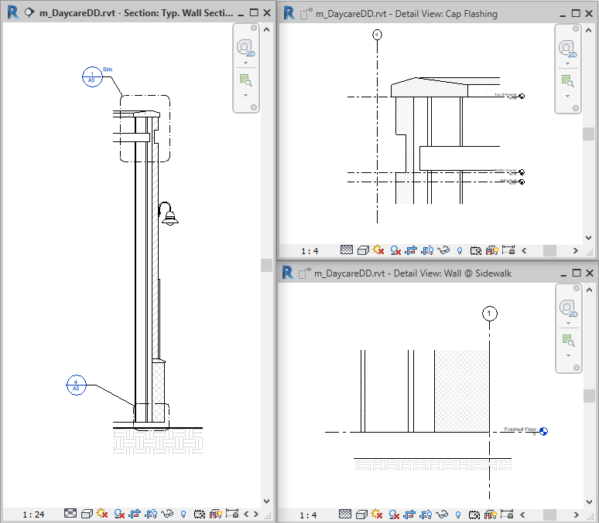
INTERPRET OUTPUT · A7
Interpreting the Model — View Range and Callouts
• View Range (Top, Cut Plane, Bottom + View Depth) controls what a plan view shows and how elements are cut.
• Callouts enlarge part of a plan, section, detail or elevation — the callout tag links parent view to callout view.
• Delete the parent view and its callouts go with it; load a callout head to place callout tags.
Application of BIM using Revit · TGS-2022015370
© 2026 Tertiary Infotech Academy Pte Ltd
92

Slide 94
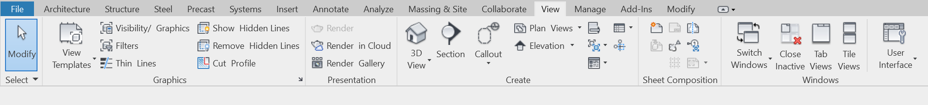
INTERPRET OUTPUT · A7
Section Views
• Add a section line and crop region to define a new section view: View ▸ Create ▸ Section, drag through the model, resize the crop with the blue controls.
• Open the section by double-clicking its header or from the Project Browser's Sections group.
• The section view updates whenever the design changes or the section line moves.
Application of BIM using Revit · TGS-2022015370
© 2026 Tertiary Infotech Academy Pte Ltd
93

Slide 95
SCHEDULES · A7
Creating a Schedule or Quantity
1
2
3
4
5
6
▶
▶
▶
▶
▶
View ▸ Schedules ▸ Schedule/Quantities
Pick the category and phase
Select fields to report
Filter, sort and group the data
Format the schedule's appearance
The schedule fills itself from the model
Application of BIM using Revit · TGS-2022015370
© 2026 Tertiary Infotech Academy Pte Ltd
94

Slide 96
COST · A7
Quantity Takeoffs and Cost Estimates
Quantity takeoffs
Essential for accurate construction cost estimating — quantify elements from the model and track element-status changes with ongoing analysis.
Material takeoffs
Tabulate materials and areas across categories — more comprehensive than component schedules alone.
1
2
Calculated values
Formula-driven reporting fields for schedules and tag labels — e.g. Cost = Area × rate; the Name becomes the column header.
Massing studies
Mass floor schedules report gross volume, floor area and surface area — preliminary cost feedback that updates as the mass changes.
3
4
Application of BIM using Revit · TGS-2022015370
© 2026 Tertiary Infotech Academy Pte Ltd
95

Slide 97
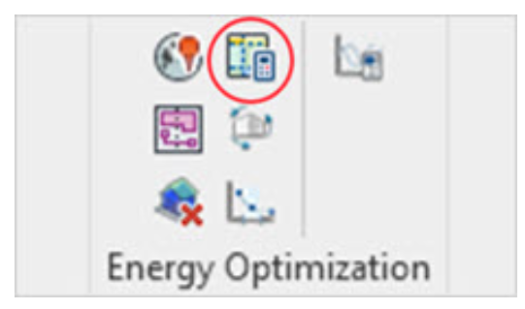
ANALYSE PERFORMANCE · A8
Revit Systems Analysis — Workflow
• Set up the model: building elements or masses, plus location; add analytical systems and define system zones; generate and revise analytical spaces.
• Revit translates the data to EnergyPlus, which runs the simulation — two default workflows: system sizing (heating/cooling loads) and annual energy simulation.
• Re-running with the same Building Type, Operating Schedule and Location groups results in the same folder; change them and a new folder is created.
Application of BIM using Revit · TGS-2022015370
© 2026 Tertiary Infotech Academy Pte Ltd
96

Slide 98
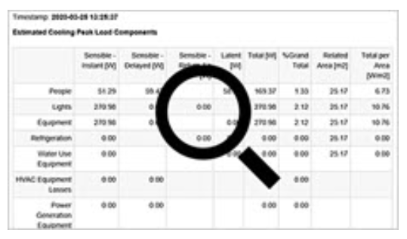
ANALYSE PERFORMANCE · A8
Reviewing Analysis Results
• Reports: Project Browser ▸ Reports ▸ Analysis Reports — a time-stamped report per run; switch Report Style between Detailed and Loads.
• Compare runs: select multiple simulations and click Compare in Results & Compare.
• Peak heating, cooling and airflow demands are also set as properties on each analytical space — the numbers live on the model.
Application of BIM using Revit · TGS-2022015370
© 2026 Tertiary Infotech Academy Pte Ltd
97

Slide 99
QUIZ
Check Your Understanding — BIM Application
What is a 4D BIM model?
A 3D model with the addition of time or scheduling data.
Avoiding conflicts between systems?
Stakeholders use clash detection software on the shared model — not emailed copies.
1
2
Design authoring is…
The process by which 3D software is used to develop a building information model.
Interference Check
Revit's built-in clash detection: Collaborate ▸ Coordinate ▸ Interference Check.
3
4
Application of BIM using Revit · TGS-2022015370
© 2026 Tertiary Infotech Academy Pte Ltd
98

Slide 100
WHAT YOU'LL DO
Hands-On Labs — BIM Application
Lab 7
Lab 8
—
• View Templates, Schedules and Quantity Takeoffs
• Energy Analysis and Design Compliance Checks
• —
Application of BIM using Revit · TGS-2022015370
© 2026 Tertiary Infotech Academy Pte Ltd
99

Slide 101
TOPIC 03 · HANDS-ON
View Templates, Schedules and Quantity Takeoffs
LAB 7
Operate BIM to produce controlled, quantified output: build a furniture-layout view with a scope box and visibility/graphic overrides and save it as a view template, then create a door schedule and a wall material takeoff, and add a calculated-value field for a preliminary cost estimate.
You'll build
A styled Floor 2 Furniture Layout view template, a sorted door schedule, and a wall material takeoff with a calculated cost column.
Tools: Autodesk Revit, Create View Template.rvt (LMS lab files)
Application of BIM using Revit · TGS-2022015370
© 2026 Tertiary Infotech Academy Pte Ltd
100

Slide 102
LAB 7 · STEP-BY-STEP
View Templates, Schedules and Quantity Takeoffs
1
Open Create View Template.rvt. Duplicate the Floor 2 plan view and rename it Floor 2 Furniture Layout, then apply the Main Zone scope box to set its crop region.
of 6
Project Browser ▸ Floor 2 ▸ Duplicate View · Properties ▸ Scope Box = Main Zone
2
Open Visibility/Graphic Overrides (VG). Override the Walls Cut pattern to Solid Fill light grey with light-grey lines, and the Furniture projection lines/pattern to red Diagonal Down-Small.
of 6
View ▸ Graphics ▸ Visibility/Graphics (VG)
Application of BIM using Revit · TGS-2022015370
© 2026 Tertiary Infotech Academy Pte Ltd
101

Slide 103
LAB 7 · STEP-BY-STEP
View Templates, Schedules and Quantity Takeoffs
3
On the Annotation Categories tab switch off Sections and set Grids to Halftone, then close VG and review the styled view.
of 6
VG ▸ Annotation Categories
4
Save the styling as a template: right-click the view ▸ Create View Template From View, and apply it to another duplicate to prove the styling is reusable.
of 6
Right-click view ▸ Create View Template From View
Application of BIM using Revit · TGS-2022015370
© 2026 Tertiary Infotech Academy Pte Ltd
102

Slide 104
LAB 7 · STEP-BY-STEP
View Templates, Schedules and Quantity Takeoffs
5
Create a door schedule: Schedule/Quantities, category Doors, add fields (Mark, Level, Width, Height, Count), and sort by Level — the schedule fills itself from the model.
of 6
View ▸ Create ▸ Schedules ▸ Schedule/Quantities ▸ Doors
6
Create a Material Takeoff for Walls with Material: Name and Material: Area, then add a Calculated Value field (e.g. Cost = Area × unit rate) to produce a preliminary cost estimate.
of 6
View ▸ Schedules ▸ Material Takeoff ▸ Calculated Value
Application of BIM using Revit · TGS-2022015370
© 2026 Tertiary Infotech Academy Pte Ltd
103

Slide 105
LAB 7 · VERIFY
View Templates, Schedules and Quantity Takeoffs
✅ Test it
Applying your view template restyles a fresh duplicate in one click; the door schedule lists every door sorted by level and updates when a door is deleted; and the wall takeoff's calculated column prices the walls from live model quantities — the model is the single quantity and cost database.
Application of BIM using Revit · TGS-2022015370
© 2026 Tertiary Infotech Academy Pte Ltd
104

Slide 106
TOPIC 03 · HANDS-ON
Energy Analysis and Design Compliance Checks
LAB 8
Analyse design performance and check compliance: set the project location and energy settings, generate the energy analytical model, run a systems analysis (EnergyPlus), read the results and reports, and run an Interference Check between structural and architectural elements to find clashes.
You'll build
An energy analysis run with its report, plus an interference-check report of clashes between element categories.
Tools: Autodesk Revit, Revit Systems Analysis (EnergyPlus), your course model or the Autodesk sample project
Application of BIM using Revit · TGS-2022015370
© 2026 Tertiary Infotech Academy Pte Ltd
105

Slide 107
LAB 8 · STEP-BY-STEP
Energy Analysis and Design Compliance Checks
1
Open the sample architecture project. Set the project's geographic Location, then open Energy Settings and set the Mode and building type for analysis.
of 6
Analyze ▸ Energy Optimization ▸ Location / Energy Settings
2
Generate the energy analytical model — Revit creates analytical spaces and surfaces from the building elements.
of 6
Analyze ▸ Energy Optimization ▸ Create Energy Model
Application of BIM using Revit · TGS-2022015370
© 2026 Tertiary Infotech Academy Pte Ltd
106

Slide 108
LAB 8 · STEP-BY-STEP
Energy Analysis and Design Compliance Checks
3
Run a systems analysis workflow: choose 'System sizing' (design heating/cooling loads) — Revit translates the model to EnergyPlus and runs the simulation.
of 6
Analyze ▸ Energy Analysis ▸ Systems Analysis
4
Review the results: open Project Browser ▸ Reports ▸ Analysis Reports and double-click the time-stamped report; switch Report Style between Detailed and Loads.
of 6
Project Browser ▸ Reports ▸ Analysis Reports
Application of BIM using Revit · TGS-2022015370
© 2026 Tertiary Infotech Academy Pte Ltd
107

Slide 109
LAB 8 · STEP-BY-STEP
Energy Analysis and Design Compliance Checks
5
Select an analytical space and read its heating, cooling and airflow peak-demand properties — the same numbers as the report, attached to the model.
of 6
Analytical Space ▸ Properties
6
Run an Interference Check between Structural Columns/Framing and Walls/Floors; export the clash report and resolve one clash, then Refresh to confirm it clears.
of 6
Collaborate ▸ Coordinate ▸ Interference Check ▸ Run Interference Check
Application of BIM using Revit · TGS-2022015370
© 2026 Tertiary Infotech Academy Pte Ltd
108

Slide 110
LAB 8 · VERIFY
Energy Analysis and Design Compliance Checks
✅ Test it
The Analysis Report opens with design heating and cooling loads for every zone, each analytical space carries its peak demands as properties, and the Interference Check lists each clash by element pair — after your fix and Refresh, the resolved clash disappears from the report.
Application of BIM using Revit · TGS-2022015370
© 2026 Tertiary Infotech Academy Pte Ltd
109

Slide 111
TOPIC RECAP
Recap — BIM Application
• You can now: LO3 — Apply BIM and check the output
Application of BIM using Revit · TGS-2022015370
© 2026 Tertiary Infotech Academy Pte Ltd
110

Slide 112
04
TOPIC 04
BIM Documentation
Maintain BIM databases and information systems · documentation required for BIM · BIM e-submission requirements and standards
Application of BIM using Revit · TGS-2022015370
© 2026 Tertiary Infotech Academy Pte Ltd
111

Slide 113
ALIGNMENT: K8–K10 · A3, A9 · LO4
Key Concepts — BIM Documentation
Documents govern BIM
BIM standards, BEP, BIP, PEP, EIR, MIDP and the Common Data Environment (CDE) govern how project information is produced and shared.
The BEP is the baseline
The BIM Execution Plan records goals, roles, deliverables, level of detail and exchange protocols — agreed at project start.
1
2
Deliverables are agreed early
Site, massing, architectural, structural and MEP models, schedules, shop drawings, as-builts and FM data — with dates.
Databases need discipline
SVY21 geo-referencing, 1:1 metric scale, file/view naming formats, colour standards and federated file structures keep the database usable.
3
4
Worksharing maintains one truth
A central model with worksets, linked files and phases lets the whole team maintain one coordinated information system.
e-Submission has rules
BCA BIM e-submission: last-saved views, cover page, core information and discipline-specific requirements must all be checked.
5
6
Application of BIM using Revit · TGS-2022015370
© 2026 Tertiary Infotech Academy Pte Ltd
112

Slide 114
DOCUMENTATION · K8
Documentation Required for BIM
BIM Standard
The standards the project's BIM must follow.
BEP — BIM Execution Plan
Overall vision + implementation details the team follows throughout the project.
1
2
BIP — BIM Implementation Plan
How the organisation rolls BIM into its practice.
PEP — Project Execution Plan
The project-wide delivery plan BIM slots into.
3
4
EIR — Employer's Information Requirements
What information the employer requires, when and how.
MIDP & CDE
Master Information Delivery Plan schedules deliverables; the Common Data Environment is the single place information is shared.
5
6
Application of BIM using Revit · TGS-2022015370
© 2026 Tertiary Infotech Academy Pte Ltd
113

Slide 115
DOCUMENTATION · K8
BIM Deliverables — Agreed Early, With Dates
Models
Site model, massing model, architectural / structural / MEP models.
Model uses
Regulatory submissions, coordination and clash detection, visualisation, cost estimation.
1
2
Programme
Schedule and phasing programme — in BIM or spreadsheet.
Construction
Construction and fabrication models, shop drawings.
3
4
Handover
As-built model in native or open formats; data for facility management.
When agreed
At project start, and after the main project members are appointed.
5
6
Application of BIM using Revit · TGS-2022015370
© 2026 Tertiary Infotech Academy Pte Ltd
114

Slide 116
DRAWINGS & SPEC · A9
Producing Drawings and Specifications
Architecture
Structure
• Architectural guidelines
– Model in stages: Conceptual, Preliminary, Detailed, Construction, As-Built
– Use the correct tool per element (Wall tool, Slab tool …); set 'Type' correctly when improvising
– 2D may complement the model for elements smaller than the agreed size (e.g. < 100 mm)
– Model elements separately per storey
• Structural guidelines
– Structural consultant produces an analysis model AND a physical model (Structural BIM)
– Covers load-bearing concrete, wood and steel + non-load-bearing concrete
– Rebar and joint details in Detailed Design stage, per tool capability
– Required parameters: Type, Material, ID, Size — Type drives quantity takeoff
Application of BIM using Revit · TGS-2022015370
© 2026 Tertiary Infotech Academy Pte Ltd
115

Slide 117
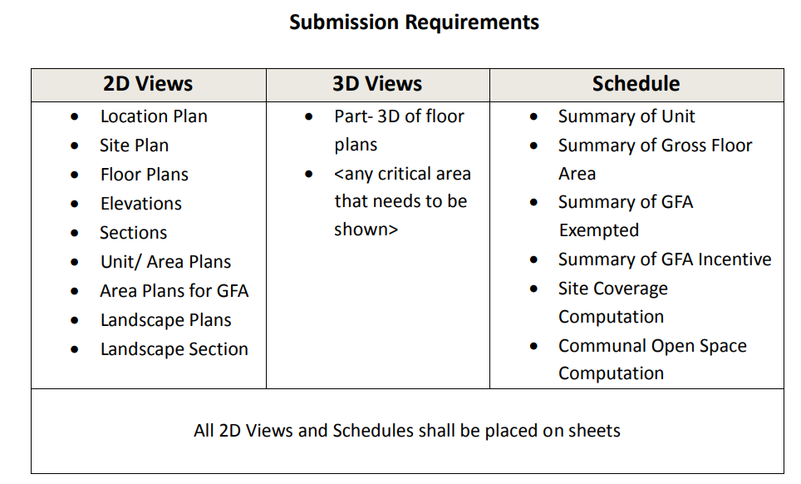
DATABASES · K9
Databases and Information Systems for BIM
The project information database: models, documents and structured data flowing through a common data environment.
Application of BIM using Revit · TGS-2022015370
© 2026 Tertiary Infotech Academy Pte Ltd
116

Slide 118
SINGAPORE STANDARDS · K9
Model Orientation, Site Configuration and Scale
SVY21 coordinates
Geo-reference the site model to SVY21 for Easting and Northing (x, y).
Singapore Height Datum
Elevations set from SHD 0.000 m for height (z).
1
2
True North
Present the site model layout in True North / real-world orientation.
Full-size metric
Model at 1:1 in metric; 2D views generated from the model must not use odd drawing scales.
3
4
Application of BIM using Revit · TGS-2022015370
© 2026 Tertiary Infotech Academy Pte Ltd
117

Slide 119
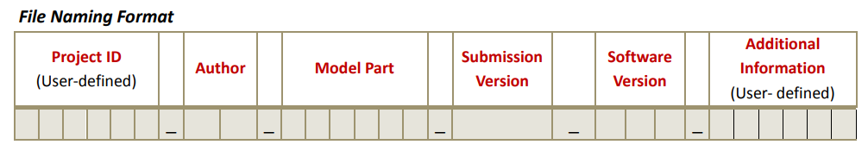
SINGAPORE STANDARDS · K9
File Naming Format
• The e-submission file name consists of 6 fields: project, originator, volume/zone, level, file type and discipline.
• Consistent naming keeps the federated model navigable for every party and every agency.
Application of BIM using Revit · TGS-2022015370
© 2026 Tertiary Infotech Academy Pte Ltd
118

Slide 120
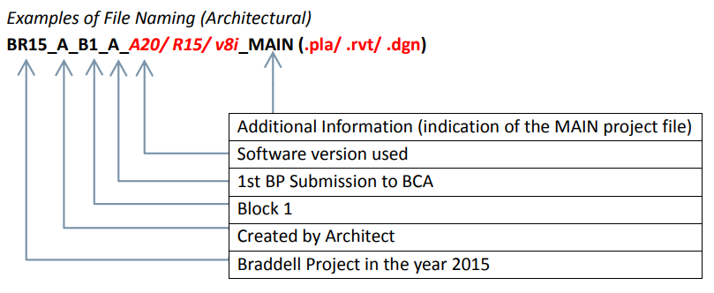
SINGAPORE STANDARDS · K9
File Naming — Worked Examples
• Architectural, MEP and structural files each follow the same 6-field pattern with their discipline code.
• The examples show real project file names for each discipline.
Application of BIM using Revit · TGS-2022015370
© 2026 Tertiary Infotech Academy Pte Ltd
119

Slide 121
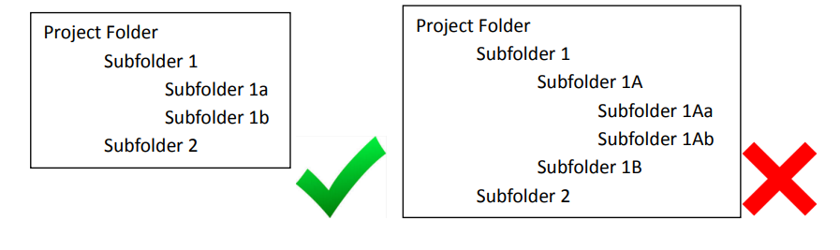
SINGAPORE STANDARDS · K9
File Structure — Single vs Federated
• Single file: one BIM file holds everything — suitable for small projects with one main building.
• Federated / linked files: several BIM files linked together — for multi-building or large projects.
• Use UNC or relative paths for links; folders no more than two sub-folders deep.
Application of BIM using Revit · TGS-2022015370
© 2026 Tertiary Infotech Academy Pte Ltd
120

Slide 122
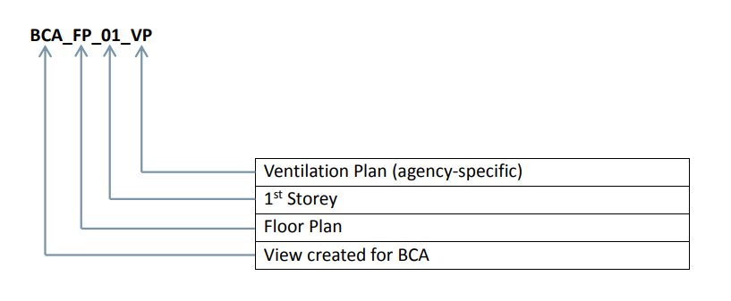
SINGAPORE STANDARDS · K9
View Naming Format
• View names use 3–4 fields (one field is agency-specific).
• The View Name field describes the particular view: 1st Storey, North Elevation, Section AA, Fire Protection Legend, Door Schedule.
• Views used in a submission keep exactly their View Name.
Application of BIM using Revit · TGS-2022015370
© 2026 Tertiary Infotech Academy Pte Ltd
121

Slide 123
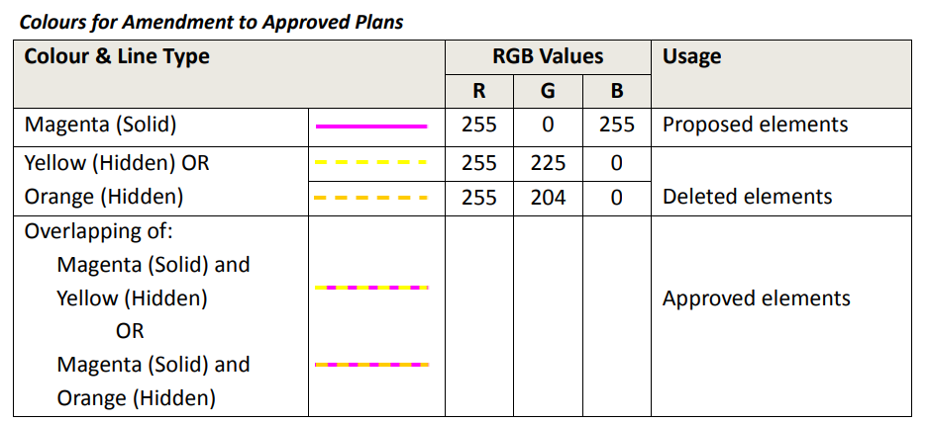
SINGAPORE STANDARDS · K10
Colour Standards for Submissions
• Amendments to approved plans use the agencies' prescribed colours.
• Addition & Alteration (A&A) works have their own colour scheme.
• Correct colours let the regulatory officer read what changed at a glance.
Application of BIM using Revit · TGS-2022015370
© 2026 Tertiary Infotech Academy Pte Ltd
122

Slide 124
E-SUBMISSION · K10
e-Submission — Last Saved Views Checklist
Maximum extent
Each view is saved at its maximum extent — agencies check the Last Saved Model and Views.
Nothing hidden
No hidden objects or annotations remain in the submitted views.
1
2
External files load
Every external file that forms part of the submission loads; none missing or unreadable.
Purged
External references, irrelevant layers, drafting work and construction lines removed before submission.
3
4
Legible fonts
No proprietary fonts; all annotation fonts legible.
All phases display
Objects and annotations in each phase display in the last saved view.
5
6
Application of BIM using Revit · TGS-2022015370
© 2026 Tertiary Infotech Academy Pte Ltd
123

Slide 125
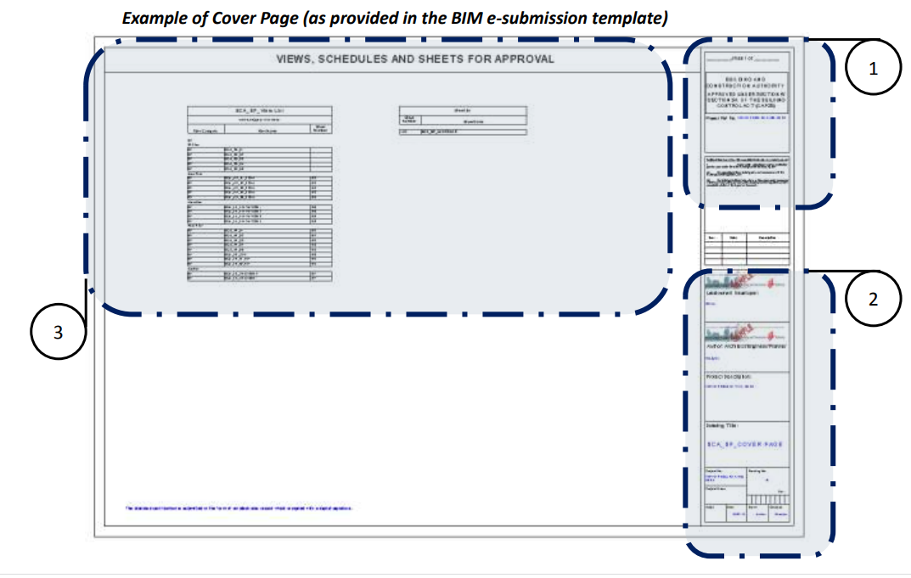
E-SUBMISSION · K10
e-Submission Cover Page and Core Information
• The cover page carries: (1) submission authority and endorsements / QP's declaration, (2) project information, (3) the list of views, schedules and sheets for approval.
• All submissions carry the minimal Core Information (CI) specified by the respective regulatory agency.
• Discipline-specific requirements come from the Code of Practice for BIM e-Submission.
Application of BIM using Revit · TGS-2022015370
© 2026 Tertiary Infotech Academy Pte Ltd
124

Slide 126
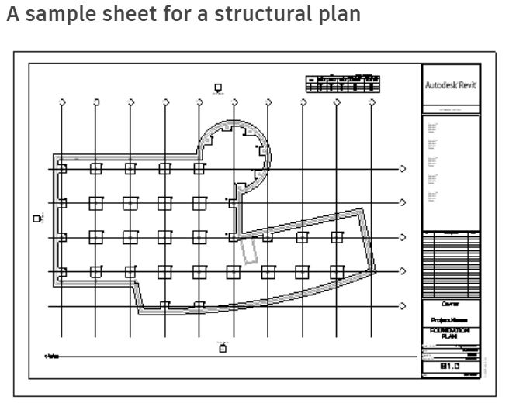
DOCUMENTATION · A9
Drawing Sheets
• A construction document set consists of sheets: View ▸ Sheet Composition ▸ Sheet.
• Drag a view or schedule onto the sheet — it becomes a viewport within the title block.
• Project templates capture sheet, view and family standards for future projects (File ▸ New ▸ Project template).
Application of BIM using Revit · TGS-2022015370
© 2026 Tertiary Infotech Academy Pte Ltd
125

Slide 127
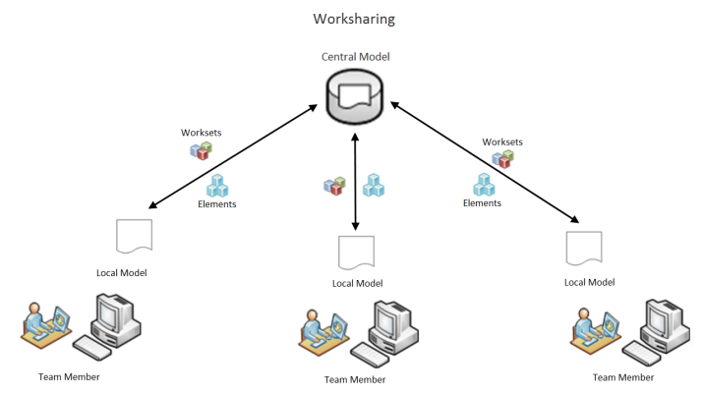
MAINTAIN THE DATABASE · A3
Worksharing — One Central Model
• Worksharing lets multiple team members work on the same project model at the same time, each on a functional area.
• Enable it via Collaborate ▸ Worksets: default worksets are created, then Save As publishes the central model.
• Team members edit local copies and synchronise with the central model.
Application of BIM using Revit · TGS-2022015370
© 2026 Tertiary Infotech Academy Pte Ltd
126

Slide 128
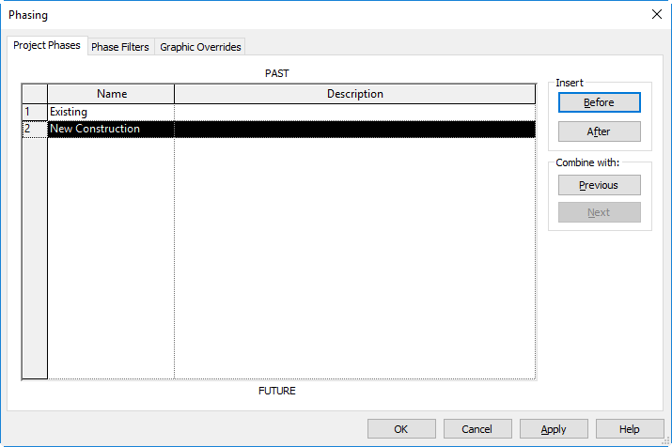
MAINTAIN THE DATABASE · A3
Phases and Design Options
• Phases track stages of work (Existing, New Construction, +custom): Manage ▸ Phasing ▸ Phases; insert before/after and rename.
• Design options develop alternatives (entries, roofs, layouts) inside one project file while the team continues on the main model.
• Options become more focused and simplified as the project progresses.
Application of BIM using Revit · TGS-2022015370
© 2026 Tertiary Infotech Academy Pte Ltd
127

Slide 129
QUIZ
Check Your Understanding — BIM Documentation
BIM Level 1
The level using 2D and 3D modeling where only CAD/PDF versions are shared with other stakeholders.
LOD specifications
Level of Development is defined at the BEGINNING of a project.
1
2
Record model
An accurate 3D representation of the physical, environmental and informational assets of a facility.
Where it's governed
The BEP + the agencies' e-submission Code of Practice.
3
4
Application of BIM using Revit · TGS-2022015370
© 2026 Tertiary Infotech Academy Pte Ltd
128

Slide 130
WHAT YOU'LL DO
Hands-On Labs — BIM Documentation
Lab 9
Lab 10
—
• Sheets, Worksharing and Linked Models
• BIM e-Submission Standards Check
• —
Application of BIM using Revit · TGS-2022015370
© 2026 Tertiary Infotech Academy Pte Ltd
129

Slide 131
TOPIC 04 · HANDS-ON
Sheets, Worksharing and Linked Models
LAB 9
Develop the construction documentation and maintain the shared model: compose a drawing sheet with a title block and viewports, add a callout and a section view, link a CAD file, enable worksharing to create a central model with worksets, and organise the project into phases.
You'll build
A titled drawing sheet carrying plan + section + callout viewports, a workshared central model with worksets, and a phased project.
Tools: Autodesk Revit, your course model, a DWG file (LMS lab files)
Application of BIM using Revit · TGS-2022015370
© 2026 Tertiary Infotech Academy Pte Ltd
130

Slide 132
LAB 9 · STEP-BY-STEP
Sheets, Worksharing and Linked Models
1
Create a sheet with a title block and drag the Level 1 plan and a schedule from the Project Browser onto it — each becomes a viewport.
of 6
View ▸ Sheet Composition ▸ Sheet
2
Add a Section through the building and a Callout of the stair area in the plan view; open both views from their heads and place them on the sheet.
of 6
View ▸ Create ▸ Section / Callout
Application of BIM using Revit · TGS-2022015370
© 2026 Tertiary Infotech Academy Pte Ltd
131

Slide 133
LAB 9 · STEP-BY-STEP
Sheets, Worksharing and Linked Models
3
Link a CAD file (e.g. a surveyor's DWG) into a site view, then compare Insert ▸ Link CAD (stays external, updates) with Insert ▸ Import CAD (embedded).
of 6
Insert ▸ Link ▸ Link CAD
4
Enable worksharing: open Worksets — accept the default worksets to create the central model, then Save As the central file so team members can make local copies.
of 6
Collaborate ▸ Manage Collaboration ▸ Worksets
Application of BIM using Revit · TGS-2022015370
© 2026 Tertiary Infotech Academy Pte Ltd
132

Slide 134
LAB 9 · STEP-BY-STEP
Sheets, Worksharing and Linked Models
5
Create a phase: open Manage ▸ Phases, insert a phase after New Construction, and assign an element to it; set a view's Phase and Phase Filter to see the effect.
of 6
Manage ▸ Phasing ▸ Phases
6
Create a design option set for an entry alternative: Manage ▸ Design Options ▸ New, add a second option, and place variant geometry in each option.
of 6
Manage ▸ Design Options
Application of BIM using Revit · TGS-2022015370
© 2026 Tertiary Infotech Academy Pte Ltd
133

Slide 135
LAB 9 · VERIFY
Sheets, Worksharing and Linked Models
✅ Test it
The sheet shows plan, section and callout viewports under a filled title block; the file is now a central model whose Worksets dialog lists your worksets; the phase filter hides/shows the phased element; and switching design options swaps the entry geometry — one database, fully documented.
Application of BIM using Revit · TGS-2022015370
© 2026 Tertiary Infotech Academy Pte Ltd
134

Slide 136
TOPIC 04 · HANDS-ON
BIM e-Submission Standards Check
LAB 10
Prepare a model for Singapore BCA BIM e-submission: apply the standard file and view naming formats, verify geo-referencing (SVY21 / SHD) and 1:1 metric scale, check the last-saved views, and assemble the submission cover page with the core information required by the regulatory agencies.
You'll build
A submission-ready model: compliant file/view names, correct coordinates and scale, purged views and a complete cover page checklist.
Tools: Autodesk Revit, your course model, BCA Code of Practice for BIM e-Submission
Application of BIM using Revit · TGS-2022015370
© 2026 Tertiary Infotech Academy Pte Ltd
135

Slide 137
LAB 10 · STEP-BY-STEP
BIM e-Submission Standards Check
1
Rename the model file to the 6-field e-submission format (project, originator, zone, level, type, discipline) and rename key views to the 3–4 field view naming format (e.g. A_1st Storey).
of 6
File naming: <Project>-<Originator>-<Zone>-<Level>-<Type>-<Discipline>
2
Verify the site model is geo-referenced to SVY21 for Easting/Northing and to Singapore Height Datum (SHD 0.000 m) for elevation, with the layout in True North orientation.
of 6
Manage ▸ Coordinates / Position ▸ True North
Application of BIM using Revit · TGS-2022015370
© 2026 Tertiary Infotech Academy Pte Ltd
136

Slide 138
LAB 10 · STEP-BY-STEP
BIM e-Submission Standards Check
3
Confirm the model is built full-size 1:1 metric, and that no 2D view generated from it uses an odd drawing scale.
of 6
Properties ▸ View Scale
4
Check every last-saved view: maximum extent saved, no hidden objects or annotations, all external files loadable, irrelevant layers/drafting purged, no proprietary fonts.
of 6
Manage ▸ Purge Unused · VG ▸ Reveal Hidden Elements
Application of BIM using Revit · TGS-2022015370
© 2026 Tertiary Infotech Academy Pte Ltd
137

Slide 139
LAB 10 · STEP-BY-STEP
BIM e-Submission Standards Check
5
Apply the colour standards for amendments and A&A works where the submission includes changes to approved plans.
of 6
6
Assemble the cover page: submission authority and QP's declaration/endorsements, project information, and the list of views, schedules and sheets for approval, with the agency's minimal Core Information.
of 6
Sheet: Cover Page ▸ QP declaration · Project info · View list
Application of BIM using Revit · TGS-2022015370
© 2026 Tertiary Infotech Academy Pte Ltd
138

Slide 140
LAB 10 · VERIFY
BIM e-Submission Standards Check
✅ Test it
Walking the e-submission checklist end-to-end passes: compliant file and view names, SVY21/SHD coordinates, 1:1 metric scale, clean last-saved views with nothing hidden or missing, correct amendment colours, and a cover page carrying the declaration, project information and view list — the model is ready for regulatory e-submission.
Application of BIM using Revit · TGS-2022015370
© 2026 Tertiary Infotech Academy Pte Ltd
139

Slide 141
TOPIC RECAP
Recap — BIM Documentation
• You can now: LO4 — Maintain BIM database and develop BIM documentation
Application of BIM using Revit · TGS-2022015370
© 2026 Tertiary Infotech Academy Pte Ltd
140

Slide 142
WRAP-UP
Course Summary & Next Steps
Application of BIM using Revit · TGS-2022015370
© 2026 Tertiary Infotech Academy Pte Ltd
141

Slide 143
LEARNING OUTCOMES
What You Achieved
Applied Revit for BIM
Navigated the Revit BIM environment and turned 2D information into an intelligent 3D model (LO1).
Developed & integrated models
Modelled walls, floors, roofs, stairs, structure, site and masses — with families and materials (LO2).
1
2
Applied BIM & checked output
Built schedules and takeoffs, ran energy analysis and interference checks on the model (LO3).
Maintained database & documentation
Workshared a central model, produced sheets, and met BCA e-submission standards (LO4).
3
4
Application of BIM using Revit · TGS-2022015370
© 2026 Tertiary Infotech Academy Pte Ltd
142

Slide 144
AFTER THE COURSE · lms-tms.tertiaryinfotech.com
Certificate & TRAQOM Survey (Mandatory)
• Complete the TRAQOM course-quality survey on the LMS — it is mandatory for WSQ funding.
• Your WSQ Statement of Attainment (SOA) is issued after you are assessed as Competent.
• Download your certificate of completion from the LMS portal.
Application of BIM using Revit · TGS-2022015370
© 2026 Tertiary Infotech Academy Pte Ltd
143

Slide 145
KEEP LEARNING
Recommended Next Courses
WSQ - Technical Drawing with AutoCAD
WSQ - Architecture Drawing with Revit
1
2
WSQ - Product Design with Fusion 360
WSQ - AutoCAD Civil 3D for Infrastructure Design
3
4
WSQ - Product Design with Autodesk Inventor
Browse all courses
www.tertiarycourses.com.sg
5
6
Application of BIM using Revit · TGS-2022015370
© 2026 Tertiary Infotech Academy Pte Ltd
144

Slide 146
WE'RE HERE TO HELP
Support
• If you have any enquiries during and after the class, contact us:
• Email: enquiry@tertiaryinfotech.com
• Tel: +65 6100 0613
• Website: www.tertiarycourses.com.sg
Application of BIM using Revit · TGS-2022015370
© 2026 Tertiary Infotech Academy Pte Ltd
145

Slide 147
FINAL ASSESSMENT
Assessment
• Written Assessment (WA) — Short-Answer Questions (SAQ), 1 hour, open book.
• Practical Performance (PP) — hands-on Revit modeling tasks, 1.5 hours, open book.
• Open book: slides, Learner Guide and approved materials only.
• Remember to take the Assessment digital attendance (TRAQOM).
• Submit your completed answers on the LMS at https://lms-tms.tertiaryinfotech.com/.
Application of BIM using Revit · TGS-2022015370
© 2026 Tertiary Infotech Academy Pte Ltd
146

Slide 148
ON ASSESSMENT DAY
Assessment Flow
1
2
3
4
5
▶
▶
▶
▶
TRAQOM survey — scan the QR code on the LMS
Assessment digital attendance — scan the SSG QR
Sit WA (SAQ, 1 hr) then PP (1.5 hrs) — open book
Submit your answers on the LMS
Sign the Assessment Summary Record
Application of BIM using Revit · TGS-2022015370
© 2026 Tertiary Infotech Academy Pte Ltd
147

Slide 149
TRAQOM · SSG DIGITAL ATTENDANCE
Digital Attendance (Mandatory)
• It is mandatory to take the AM, PM and Assessment digital attendance for WSQ-funded courses.
• The trainer/administrator displays the digital attendance QR code from the SSG portal.
• Scan the QR code with your mobile phone camera and submit your attendance.
• A minimum of 75% attendance is required to be eligible for assessment and funding.
Application of BIM using Revit · TGS-2022015370
© 2026 Tertiary Infotech Academy Pte Ltd
148

Slide 150
HAPPY MODELLING
Thank You!
You are now ready to apply, model, manage and document BIM projects with Autodesk Revit.
Application of BIM using Revit · TGS-2022015370
© 2026 Tertiary Infotech Academy Pte Ltd
149

